Slide 1
Unifying Features of Archegoniate, Transition to Land Habit and Alternation of Generation
Dr Habibur Rahman, Associate Professor
J. N. College, Boko

Slide 8
8. During the formation of spores, the spore mother cells divide meiotically
and haploid spores are formed.
9. The production of the spores is the beginning of the gametophytic or
haploid phase
10. The spores germinate and form gametophytic or haploid phase
11. The spores germinate and produce gametophytes, which bear sex
organs. Ultimately, the gametic union takes place and zygote is resulted.
12. It is diploid (2n).This is the beginning of the sporophytic or diploid phase.

Slide 9
13. Here the two generations are morphologically different, the type of alternation of generations is called heteromophic
14. The gametophytic generation is conspicuous and longer- lived phase of life-cycle in comparison to that of sporophyte generation
15. In bryophytes, the gametophyte is quite independent whereas the sporophyte is dependent somehow or other on the gametophyte for its nutrition
16. The gametophyte produces sporophyte and sporophyte to the gametophyte and thus there is regular alternation of generations

Slide 10
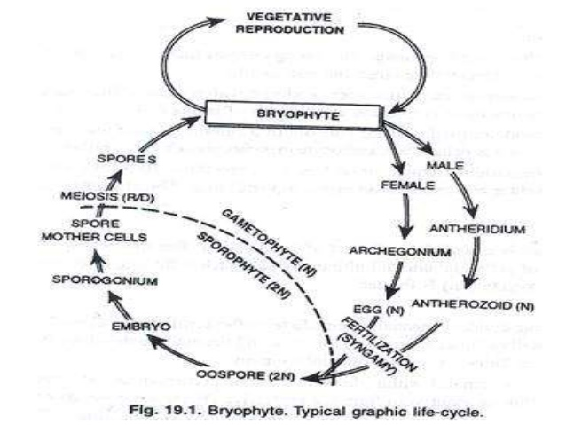

Slide 11
Alternation of generation: Pteridophytes
In Pteridophytes, the haploid phase (n) is gametophytic generation or sexual phase
It bears reproductive organs -anthredia and archegonia.
The Anthredia and archegonia produces flagellate antherozoids and egg respectively. Gametophyte may be monoecious as in homosporous sp. / dioecious in heterosporous sp.
The Gametophyte is independent in Pteris and dependent in Selaginella.
Diploid phase (2n) or sporophytic stage forms from zygote after fertilization

Slide 12
6. Meiosis in SMC (spore mother cell) forms non-motile haploid spore, which germinate to form gametophyte again.
7. This cycle continues with alternation between gametophye and sporophyte.All spore formed may be of one type i.e. homosporous species (Lycopodium, Dryopteris).
8. Spores formed may be of two types i. e. heterosporous species (Selaginella, Marsilea).Microspores/male spores developed in male sporangia germinate to form male gametophyte.
9. Megaspores/female spore developed in megasporangia germinate to form female gametophyte.

Slide 13
10. Sporophyte is dominant phase in life cycle.
11. It is independent of the gametophyte (prothallus) and grows to a much greater size.
12. Sporophytes are differentiated into stems, leaves and roots and shows well developed conducting tissues.

Slide 14
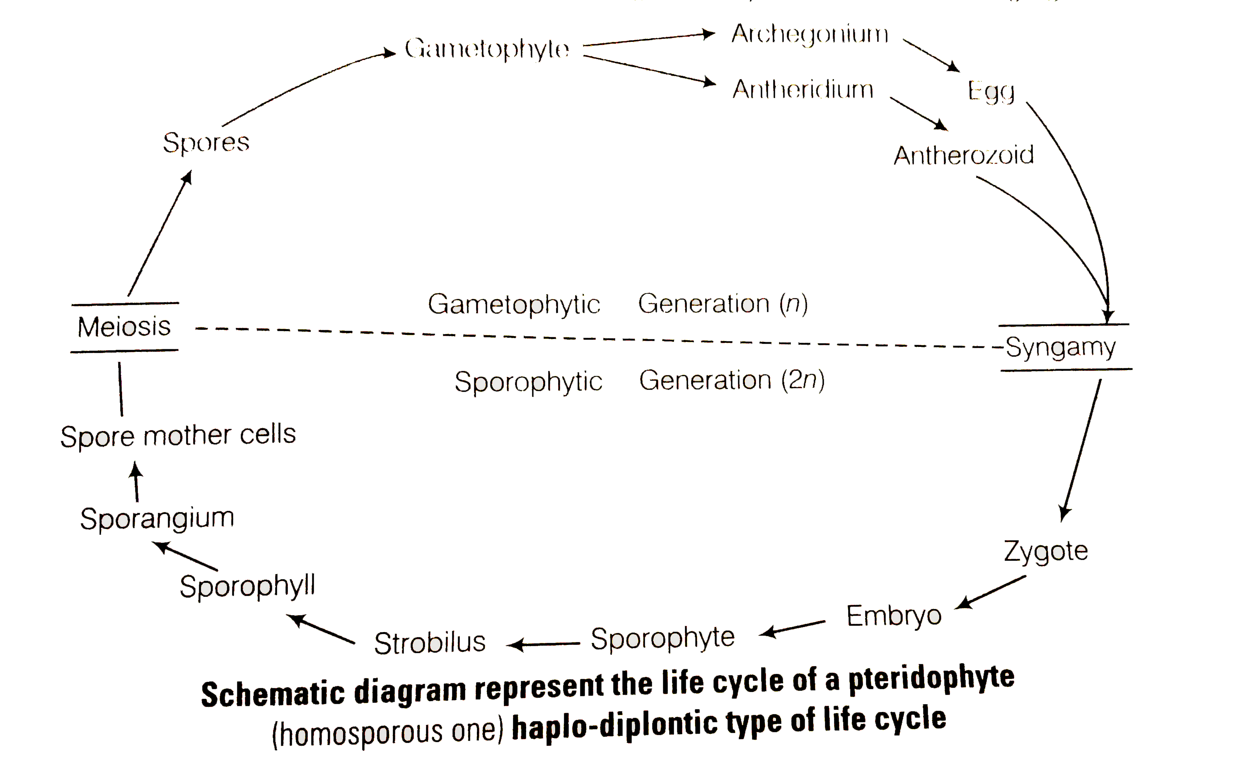

Slide 15
Alternation of generation: Gymnosperms
1. The dominant phase in the life cycle is the diploid (sporophyte) stage.
2. The gametophytes are very small and cannot exist independent of the parent plant.
3. The reproductive structures of the sporophyte (cones), produce two different kinds of haploid spores: microspores (male) 4. and megaspores (female).
4. This phenomenon of sexually differentiated spores is called heterospory.
5. These spores give rise to similarly sexually differentiated gametophytes, which in turn produce gametes.
6. Fertilization occurs when a male and female gamete join to form a zygote.resulting embryo, encased in a seed coating, become sporophyte.

Slide 16
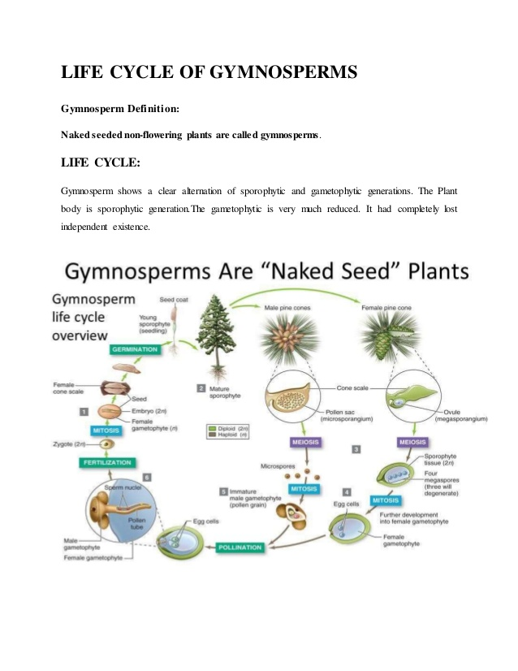

Slide 17
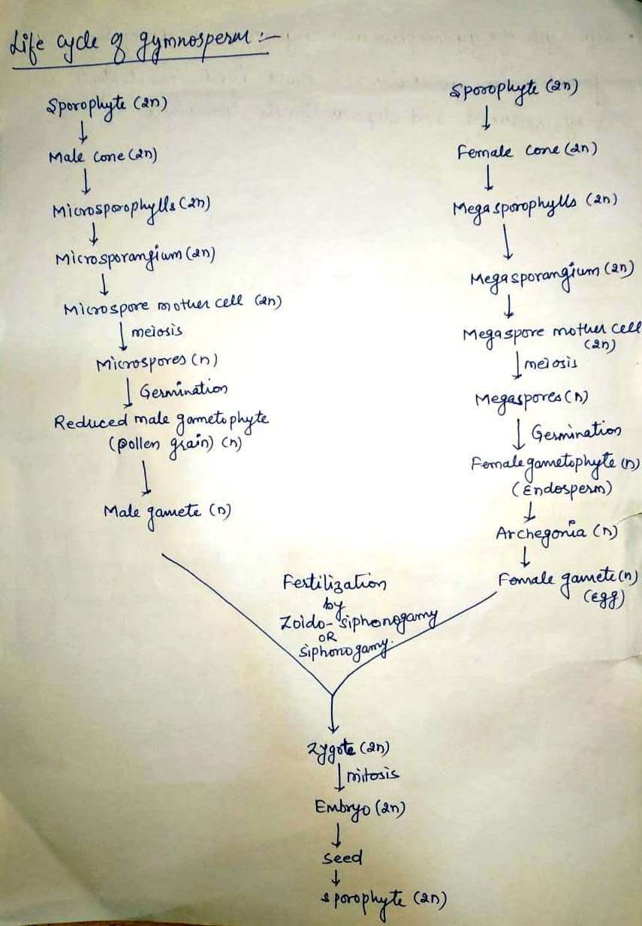

Slide 18
