Slide 1
Plant Identification & Classification
Dr Habibur Rahman
Associate Professor
J. N. College, Boko

Slide 12
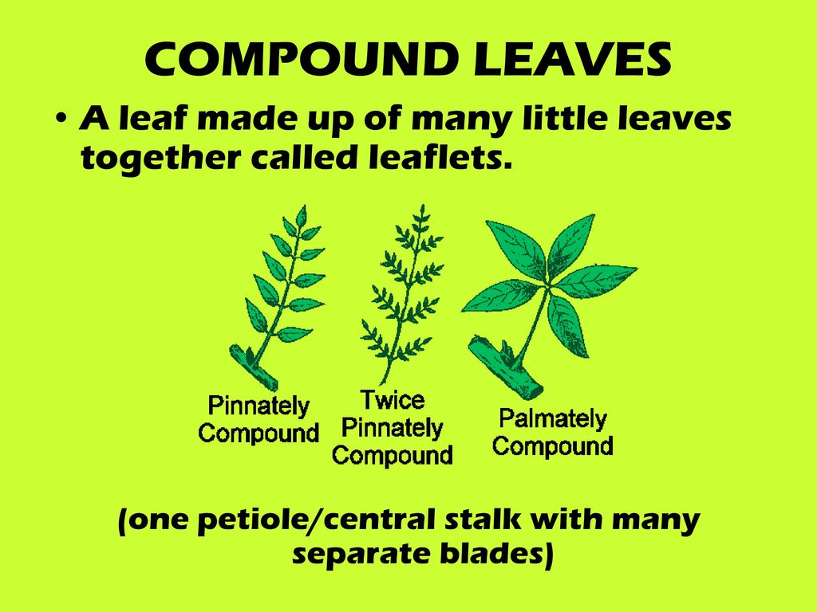

Slide 15
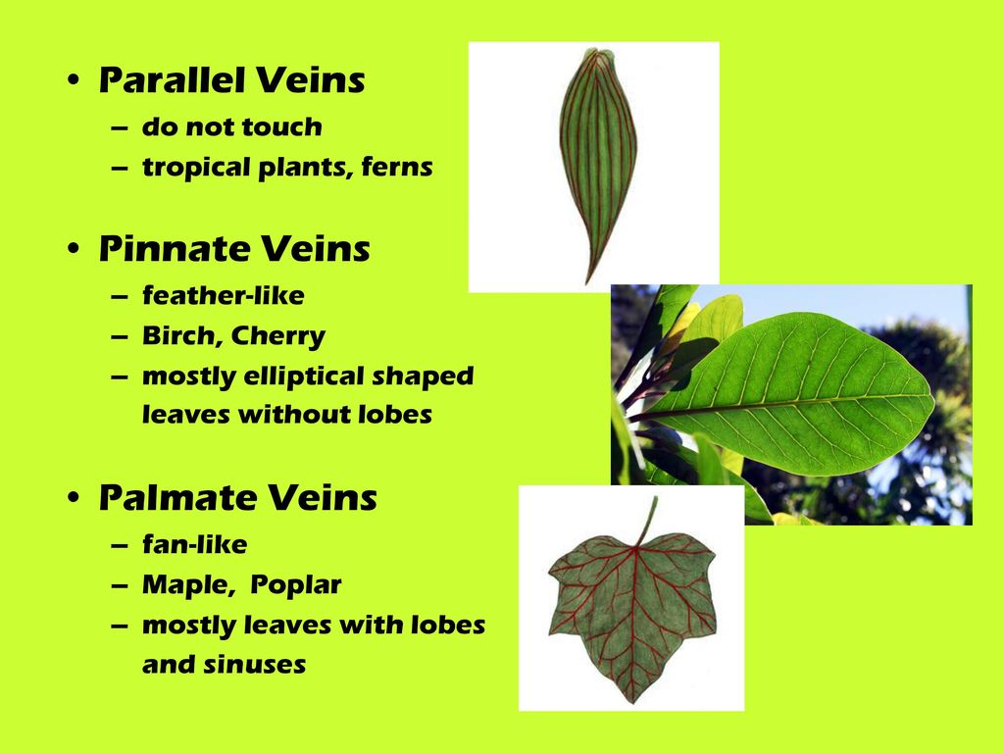

Slide 20
Meaning of Plant Classification:
Plant Classification is the arrangement of plants into groups and categories for a clear understanding, proper study and effective organization. According to Radford (1986) “classification is the arrangement of groups of plants with particular circumscriptions by rank and position according to artificial criteria, phenetic similarities, or phylogenetic relationships”.

Slide 21
HOW ARE PLANTS CLASSIFIED?
Science classifies living things in an orderly system through which they can be readily identified. Living things are grouped into categories of increasing size, based upon relationships within those categories. For example, all plants can be put in order from the more primitive to the more advanced. Such a ranking would look like this.

Slide 22
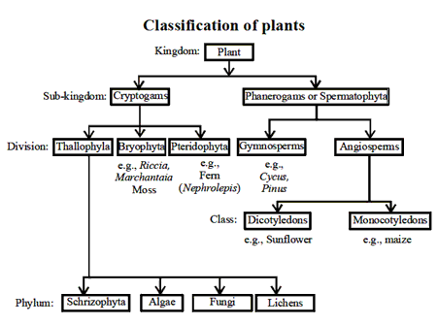

Slide 27
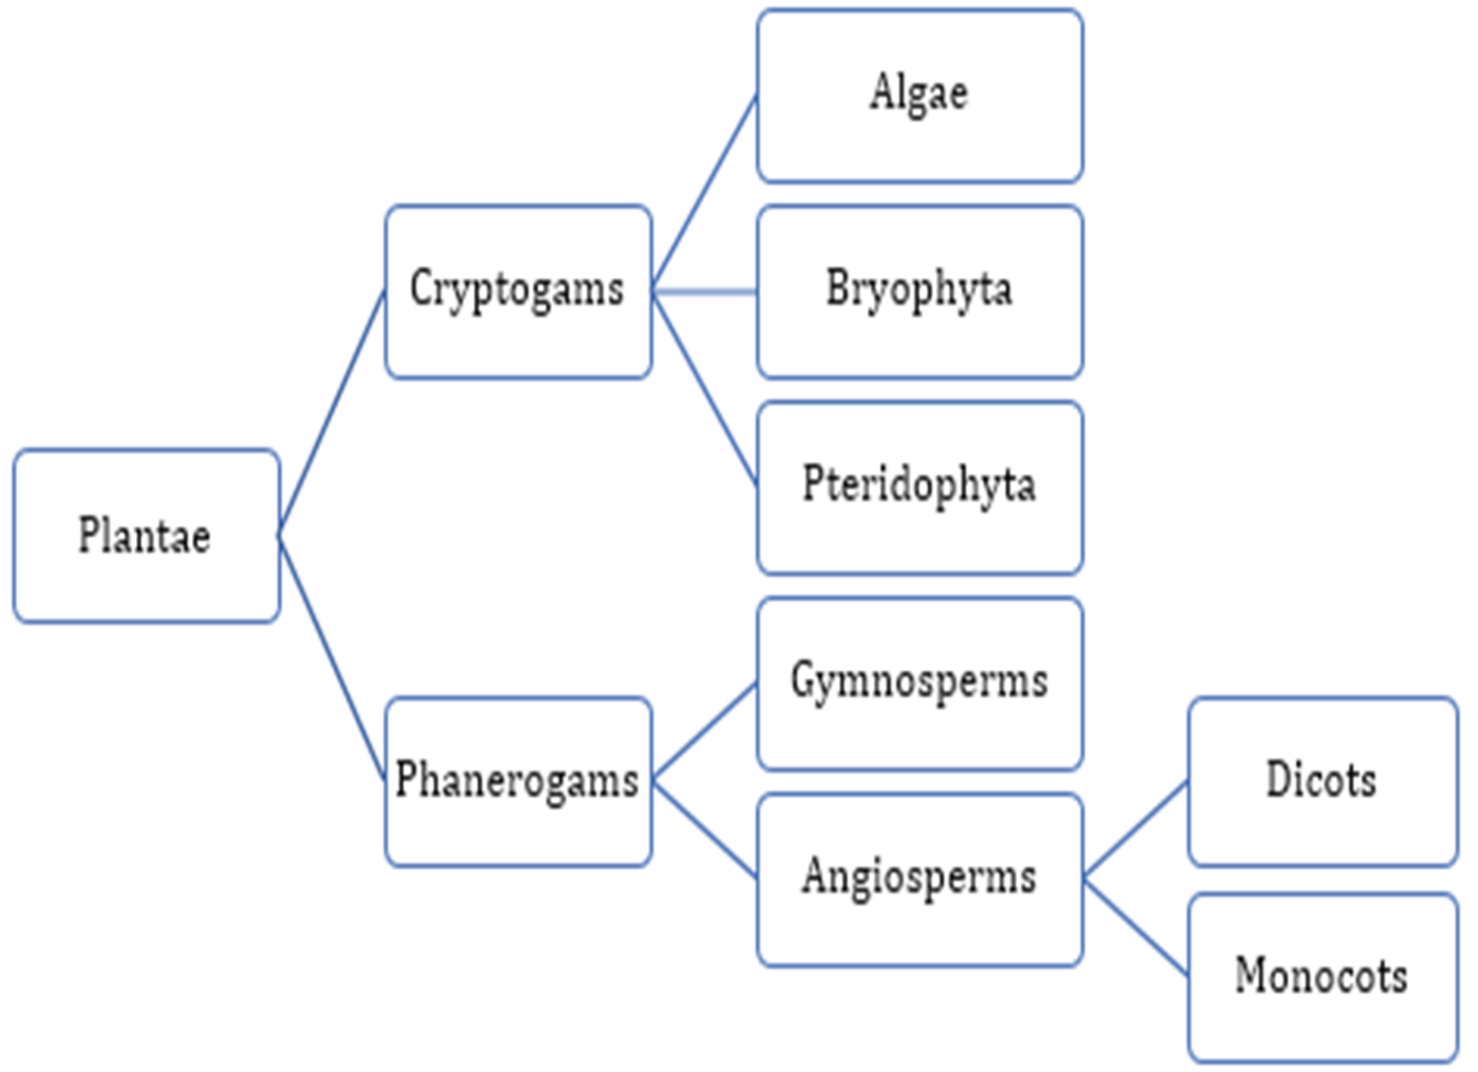

Slide 33
