Slide 1
Anthoceros – General Account
Dr Habibur Rahman
Associate Professor
J. N. College, Boko

Slide 3
Distribution and Habitat:
Anthoceros is represented by about 200 species. All species are terrestrial and cosmopolitan in distribution. The species grow in very moist and shady places like slopes, rocks or sides of the ditches. Some species are found growing on decaying wood (Cavers, 1911). Unlike other bryophytes Anthoceros is usually not well adapted to resist dry conditions. In India 25 species are found.

Slide 4
In India Anthoceros is represented by about 25 species. Out of these three species of Anthoceros viz., A. himalayensis, A. erectus and A. chambensis are commonly found growing in the Western Himalayan region at an altitude of 5000-8000 feet (Kashyap, 1915). These species are also found growing in Mussoorie, Kulu, Manali, Kumaon, Chamba valley, Punjab, Madras and in plains of South India.
Mehra and Handoo (1953) reported A. himalayensis and A. erectus from Simla, Nainital and Dalhousie. Some other species of Anthoceros and their places of occurrence are—A. dixitii, A. sahyadrensis (Poona and neighbouring hills), A. crispulus (Lucknow), A. assamicus (Assam), A. shvianandani (Kerala) etc. The species of Anthoceros may be perennial (A. himalayensis) or annual (A. erectus).

Slide 6
Gametophytic Phase :
External Features:
The gametophytic plant body is thalloid, dorsiventral, prostrate, dark green in colour with a tendency towards dichotomous branching. Such branching results into an orbicular or semi orbicular rosette like appearance of the thallus.
The thallus is bilobed (A. himalayensis, Fig. 1 A) or pinnately branched (A. hallii) or spongy with large number of sub-spherical spongy bodies like a gemma (A. gemmulosus fig. 1 C) or raised on a thick vertical stalk like structure (A. erectus, fig 1. B).

Slide 7
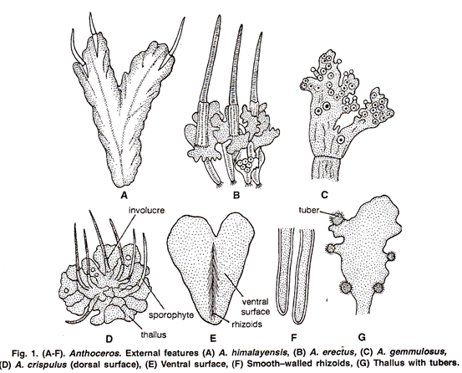

Slide 8
Dorsal Surface:
The dorsal surface of the thallus may be smooth (A. laevis) or velvety because of the presence of several lobed lamellae (A. crispulus) or rough with spines and ridges (A. fusiformis). It is shining, thick in the middle and without a distinct mid rib (Fig. 1 D).

Slide 9
Ventral Surface:
The ventral surface bears many unicellular, smooth-walled rhizoids (Fig. 1 E, F). Their main function is to anchor the thallus on the substratum and to absorb water and mineral nutrients from the soil. Tuberculated rhizoids, scales or mucilaginous hairs are absent. Many small, opaque, rounded, thickened dark bluish green spots can be seen on the ventral surface. These are the mucilage cavities filled with Nostoc colonies.
In the month of September and October the mature thalli have erect, elongated and cylindrical sporogonia. These are horn like and arise in clusters. Each sporogonium is surrounded by a sheath like structure on its base. It is called involucre (Fig. 1 D).

Slide 11
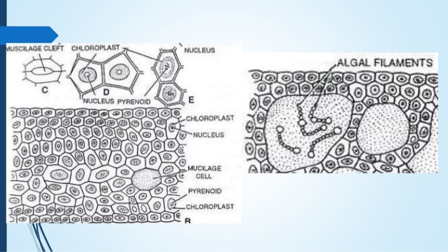

Slide 17
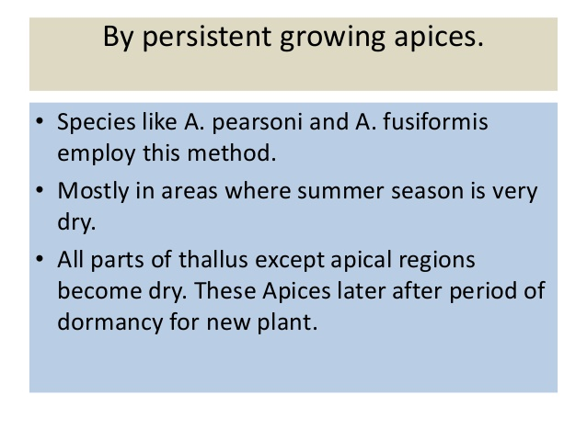

Slide 18
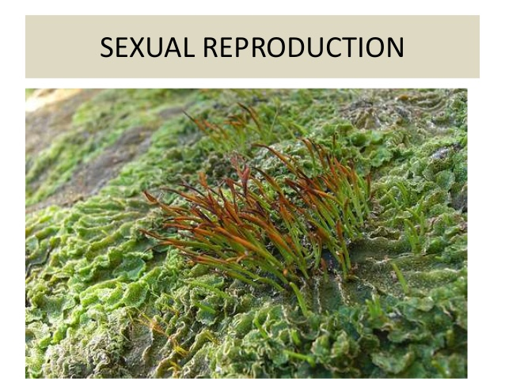

Slide 25
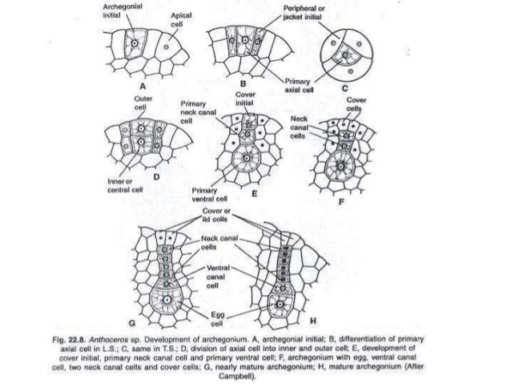

Slide 28
Fertilization:
Water is essential for fertilization. In the mature archegonium, the venter canal cell, neck canal cells disintegrate and form a mucilaginous mass. It absorbs water, swells up and becomes out of the archegonial neck by pushing the cover cells apart. This mucilaginous mass becomes continuous with the mucilage mound and in this way an open passage down to egg is formed.
The mucilaginous mass consists of chemical substances. Many antherozoids caught in the mucilage enter in the archegonial neck because of the chemotactic response, reach upto the egg, and fertilization is effected. Prior to fertilization, egg enlarges and fills the cavity of the venter. Fusion of both male and female nuclei results in the formation of diploid zygote or oospore. Fertilization ends the gametophytic phase.

Slide 30
Sporophytic Phase:
After fertilization the diploid zygote or oospore still enlarges in size and fills the cavity of the venter of the archegonium. It secretes an outer cellulose wall.

Slide 33
