Slide 1
Taxonomic Studies
Dr. Habibur Rahman
Associate Professor
J. N. College,Boko

Slide 2
Alpha(Classical), Omega(Modern) and
Cladistic Taxonomy

Slide 4
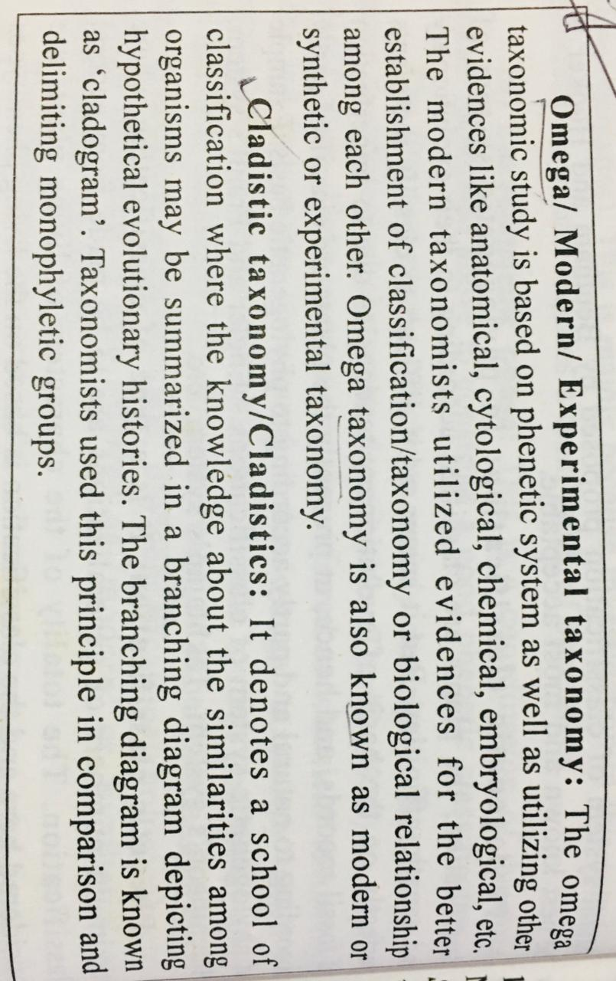

Slide 5
Difference between Alpha & Omega Taxonomy

Slide 6
Modern trends in taxonomy
Taxonomists now accept that, the morphological characters alone should not be considered in systematic classification of plants. The complete knowledge of taxonomy is possible with the principles of various disciplines like Cytology, Genetics, Anatomy, Physiology, Geographical Distribution, Embryology, Ecology, Palynology, Phenology, Bio-Chemistry, Numerical Taxonomy and Transplant Experiments. These have been found to be useful in solving some of the taxonomical problems by providing additional characters. It has changed the face of classification from alpha (classical) to omega (modern kind). Thus the new systematic has evolved into a better taxonomy.

Slide 10
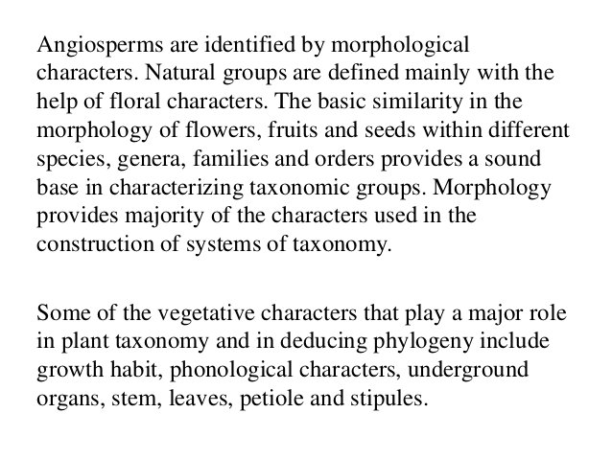

Slide 11
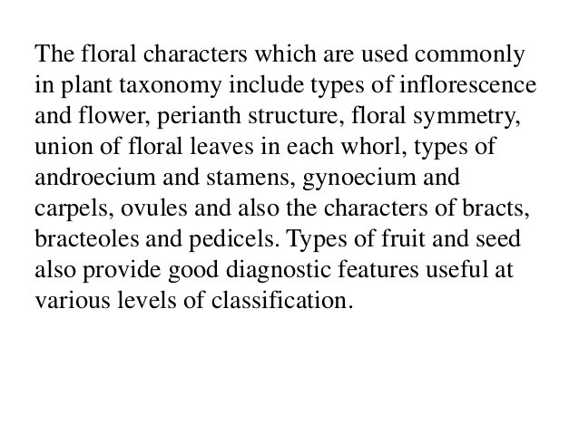

Slide 12
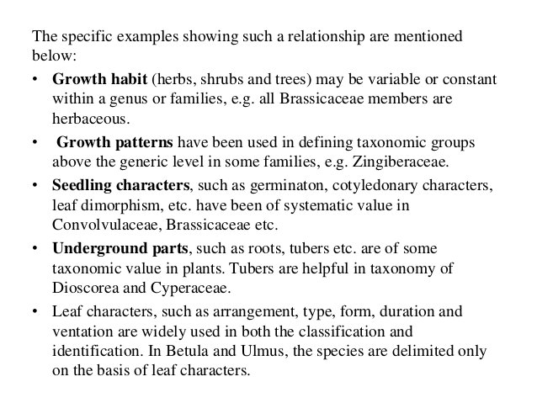

Slide 13
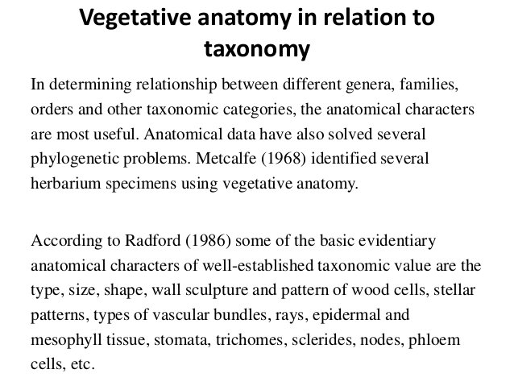

Slide 19
Karyotaxonomy
Chromosomes are the carriers of genetic information. Increased knowledge about the chromosomes have been used for extensive biosystematic studies and resolving many taxonomic problems. Utilization of the characters and phenomena of cytology for the explanation of taxonomic problem is known as cytotaxonomy or karyotaxonomy. The characters of chromosome such as number, size, morphology and behaviour during meiosis have proved to be of taxonomic value.

Slide 21
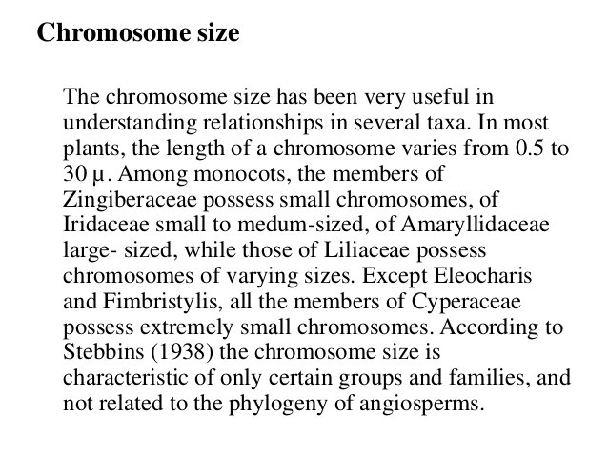

Slide 24
Serotaxonomy (immunotaxonomy)
Systematic serology or serotaxonomy had its origin towards the end of twentieth century with the discovery of serological reactions and development of the discipline of immunology. The classification of very similar plants by means of differences in the proteins they contain, to solve taxonomic problems is called serotaxonomy. Smith (1976) defined it as “the study of the origins and properties of antisera.”

Slide 25
Importance of serotaxonomy
It determines the degree of similarity between species, genera, families etc. by comparing the reactions of antigens from various plant taxa with antibodies raised against the antigen of a given taxon.
Example: 1. The assignment of Phaseolus aureus and P. mungo to the genus Vigna is strongly supported by serological evidence by Chrispeels and Gartner

Slide 26
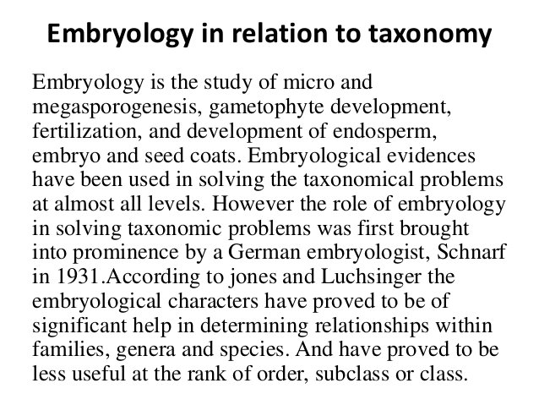

Slide 27
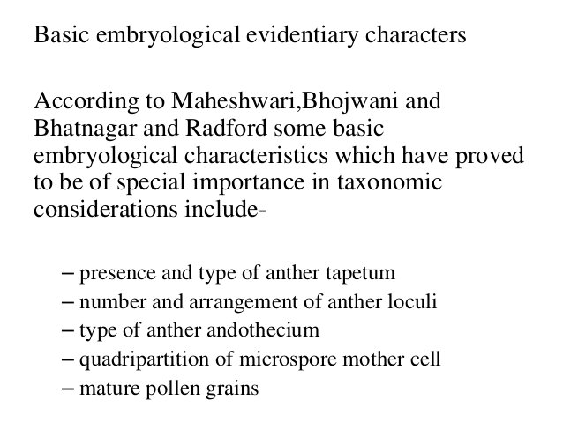

Slide 28
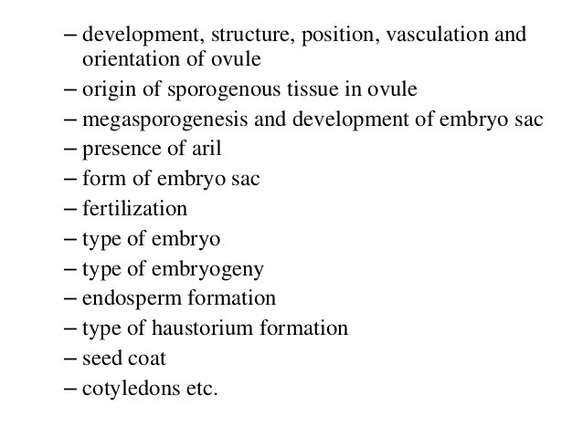

Slide 29
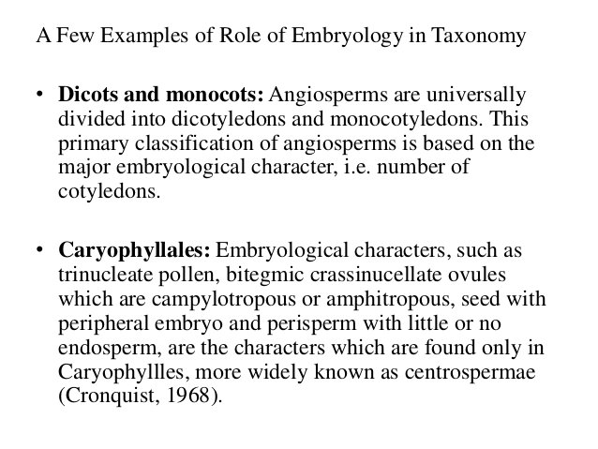

Slide 30
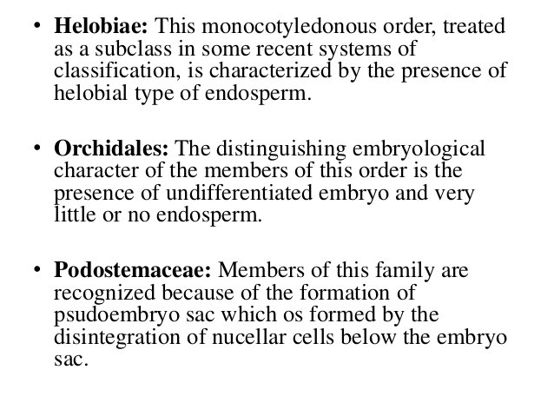

Slide 34
Chemotaxonomy
Various medicines, spices and preservatives obtained from plant have drawn the attention of Taxonomists. Study of various chemicals available in plants help to solve certain taxonomical problems. Chemotaxonomy is the scientific approach of classification of plants on the basis of their biochemical constituents. As proteins are more closely controlled by genes and less subjected to natural selection, it has been used at all hierarchical levels of classification starting from the rank of ‘variety’ up to the rank of division in plants. Proteins, amino acids, nucleic acids, peptides etc. are the most studied chemicals in chemotaxonomy.
The chemical characters can be divided into three main categories.
1. Easily visible characters like starch grains, silica etc.
2. Characters detected by chemical tests like phenolics, oil, fats, waxes etc.
3. Proteins

Slide 35
Aims of chemotaxonomy
1. To develop taxonomic characters which may improve existing system of plant classification.
2. To improve present day knowledge of phylogeny of plants.

Slide 39
