Slide 1
DEMOGRAPHIC TRANSITION MODEL

Slide 2
WHAT IS DEMOGRAPHIC TRANSITION MODEL?
It is a phenomenon which refers to the historical shift from high birth rates and high infant death rates in societies with minimal technology ,education and economic development, to low birth rates and low death rates in societies with advanced technology, education and economic development, as well as stages between these scenarios.

Slide 3
Founders of the theory
The theory is based on the interpretation of demographic history by Warren Thompson in the year 1929 but later on a formal representation of this theory was given by Notestian in 1950s.

Slide 4
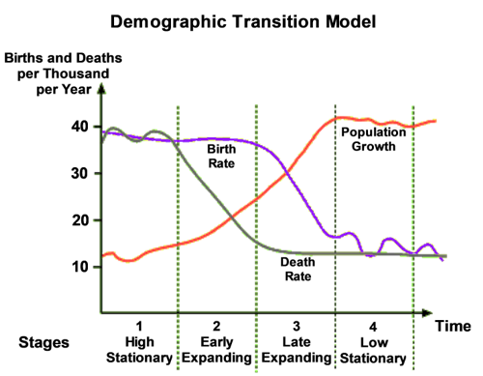
DIAGRAMMATIC REPRESENTATION OF THE MODEL

Slide 5
EXPLANATION OF THE MODEL
The theory consist of 4 stages-
FIRST STAGE
Both the death rate and the birth rate remained very high.
The population growth is highly stationary.
Society was engaged in primary activities basically.

Slide 6
Reasons for high birth and death rate
High BR Reasons
High DR reasons
High infant mortality
Lack of contraceptives
Children were considered as economic assets
Large family was a social norm
Poor nutrition
Lack of medical facility
Poor sanitation

Slide 7
SECOND STAGE
The birth rate remains high as in the first stage
The death rate shows a declining trend
The population count increases at a slow pace
Death rate declines due to improved nutrition, improved medical care
and better sanitation measures.
Zimbabwe,Kenya,Ghana, Afghanistan are in this stage.

Slide 8
THIRD STAGE
The birth rate shows a declining trend.
The death rate shows a constant trend which is little less than the second stage.
The birth rate falls due to access to contraception, urbanization, reduction in subsistence agriculture, increase in education of females.
Total population rises at its fastest rate at the start of this stage when the surplus of births over deaths is at its maximum. However towards the end of this stage the gap between the birth and the death reduces till birth outnumbers death.
Countries like Jamaica,India,Malaysiya have witnessed low birth rates

Slide 9
FOURTH STAGE
Both the birth rate and death rate declines. They are in balance.
Birth rates may drop below replacement level as has happened in countries like Germany, Italy and Japan leading to shrinking population.
Low death rate has caused ageing population problem in many developed nation
Countries like Argentina,Bhutan,Mexico,Sri lanka are in this stage.

Slide 10
INDIA AND DEMOGRAPHIC TRANSITION MODEL
India too is following the demographic transition model.
Death rate began to fall after 1920 but the birth rate remained high up to 1960s resulting in huge population growth.
India witnessed a small decline in population in the last decade.
The population pyramid wasa wide at the bottom but by 2001 the bottom is narrowed and a bulge is moving upward suggesting fall in fertility
Population dividend has been seen in population structure which is a positive indication showing less dependent population.

Slide 11
CRITICISM
It can only predict the future of population growth pattern but can not always speak the reality.
Population growth includes three primary factors i.e birth rate,death rate and migration.but this model is silent on the migration factor.
This model fails to explain the exact time needed to pass from one stage to the next stage
This model has shown different time period in different continents to pass through various stages.
This model does not include the social factors like education of women which lowers birth rate.

Slide 12
Thank you

