Slide 1
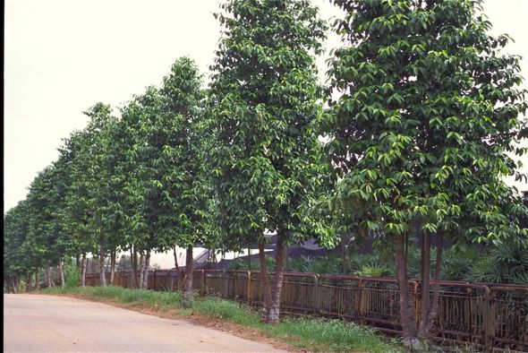
Life History of Gnetum
Dr. Habibur Rahman
Associate Professor
J. N. College, Boko

Slide 2
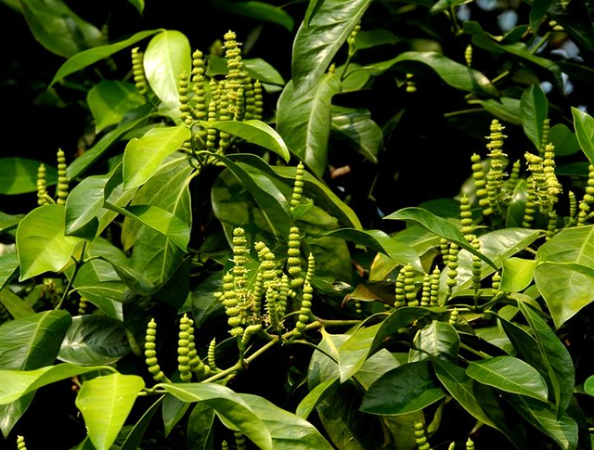
Male Cone

Slide 3
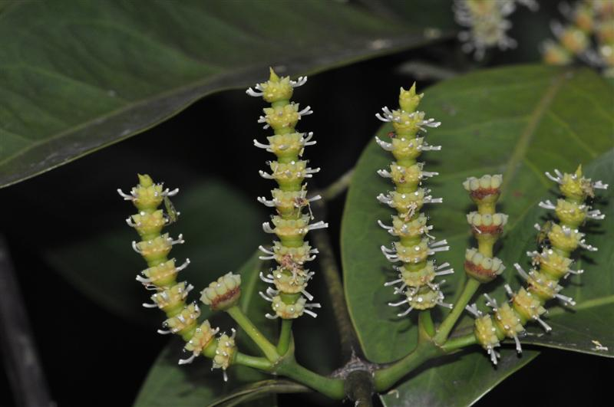
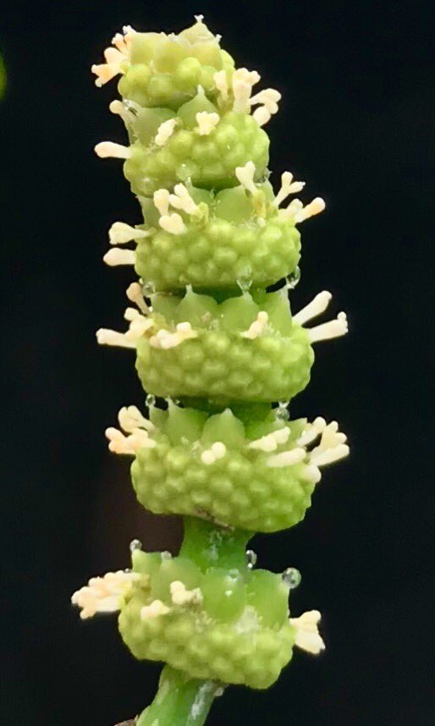
Male Cone

Slide 4
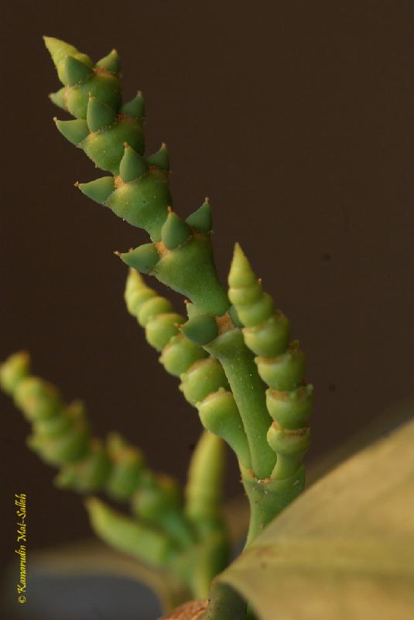
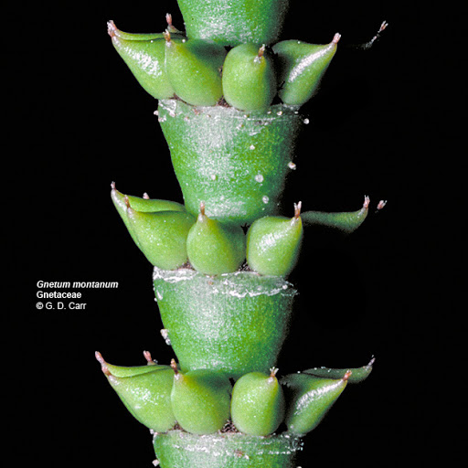
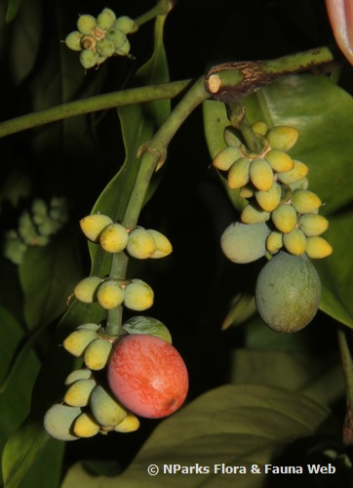
Female Cone

Slide 5
Gnetum
■ Systematic position:
Division- Gnetophyta
■ Class- Gnetopsida
■ Order- Gnetales
■ Family- Gnetacceae
■ Genus- Gnetum
■ Distribution and habit
■ It consists of thirty species, widely distributed in the tropical and sub-tropical zones of the world.
■ Most of the species are lianas.
■ Common Indian species: G. ula,
■ G. gnemon,
■ G. latifolium,
■ G. montanum,
■ G. contractum

Slide 6
Distribution of Gnetum:
Gnetum, represented by about 40 species is confined to the tropical and humid regions of the world. Nearly all species, except G. microcarpum, occur below an altitude of 1500 metres. Five species (Gnetum contractum, G. gnemon, G. montanum, G. ula and G. latifolium) have been reported from India (Fig. 13.1). Gnetum ula is the most commonly occurring species of India.
According to Bhardwaj (1957) various species of Gnetum occur in India in the following regions:
Gnetum ula:
It is a woody climber having branches with swollen nodes. It is found in Western Ghats near Khandala, forests of Kerala, Nilgiris, Godawari district of Andhra Pradesh and Orissa.
Gnetum contractum:
A scandent shrub growing in Kerala, Nilgiri Hills and Coonoor in Tamil Nadu.
Gnetum gnemon:
A shrubby plant found in Assam (Naga-Hills, Golaghat and Sibsagar).
Gnetum montanum:
A climber with smooth, slender branches, swollen at the nodes. It is found in Assam, Sikkim and parts of Orissa.
Gnetum latifolium:
A climber found in Andaman and Nicobar Islands

Slide 8
Leaf Anatomy
Internally, Gnetum leaves also resemble with a dicot leaf. It is bounded by a layer of thickly circularized epidermis on both the surfaces. Stomata are distributed all over the lower surface except on the veins. The mesophyll is differentiated generally into a single-layered palisade and a well-developed spongy parenchyma.
Many stellately branched sclereids are present near the lower epidermis in the spongy parenchyma. Many stone cells and latex tubes are present in the midrib region of the leaf.
Several vascular bundles in the form of an arch or curve are present in the prominent midrib region (Fig. 13.9). A ring of thick-walled stone cells is present just outside the phloem. Each vascular bundle is conjoint and collateral.
The xylem consists of tracheids, vessels and xylem parenchyma while the phloem consists of sieve cells and phloem parenchyma.

Slide 9
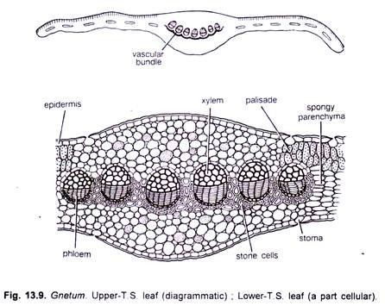

Slide 10
Stem Anatomy
The young stem in transverse section is roughly circular in outline, and resembles with a typical dicotyledonous stem. It remains surrounded by a single-layered epidermis, which is thickly circularized and consists of rectangular cells. Some of the epidermal cells show papillate outgrowths. Sunken stomata are present.
The cortex consists of outer 5-7 cells thick chlorenchymatous region, middle few-cells thick parenchymatous region and inner 2-4 cells thick sclerenchymatous region. Endodermis and pericycle regions are not very clearly distinguishable. Several conjoint, collateral, open and endarch vascular bundles are arranged in a ring (Fig. 13.5) in the young stem.
Xylem consists of tracheitis and vessels. Presence of vessels is an angiospermic character. Protoxylem elements are spiral or annular while the metaxylem shows bordered pits which are circular in outline. The phloem consists of sieve cells and phloem parenchyma.

Slide 11
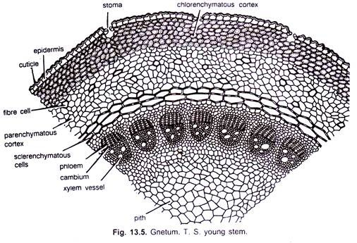

Slide 12
Reproduction
■ -Gnetum reproduces sexually.
■ -Gnetum is dioecious and both the male and female strobili (inflorescence) are compound.
■ -The inflorescence is either axillary or terminal in position. The inflorescence may be single or in groups.
■ -The inflorescence is composed of a stout long axis with two opposite decussate, connate bracts at the base and a series of cup-like bracts called cupules or collars that are superposed one above the other.
■ There are many rings of flowers in the axil of collars. The collars are developed in acropetal succession and the flowers are initiated as mounds of meristematic cells from the lower surface of a collar.
■A cone consists of a cone axis, at the base of which are present two opposite and connate bracts. Nodes and internodes are present in the cone axis. Whorls of circular bracts are present on the nodes. These are arranged one above the other to form cupulas or collars . Flowers are present in these collars. Upper few collars may be reduced and are sterile in nature in G. gnemon.

Slide 13
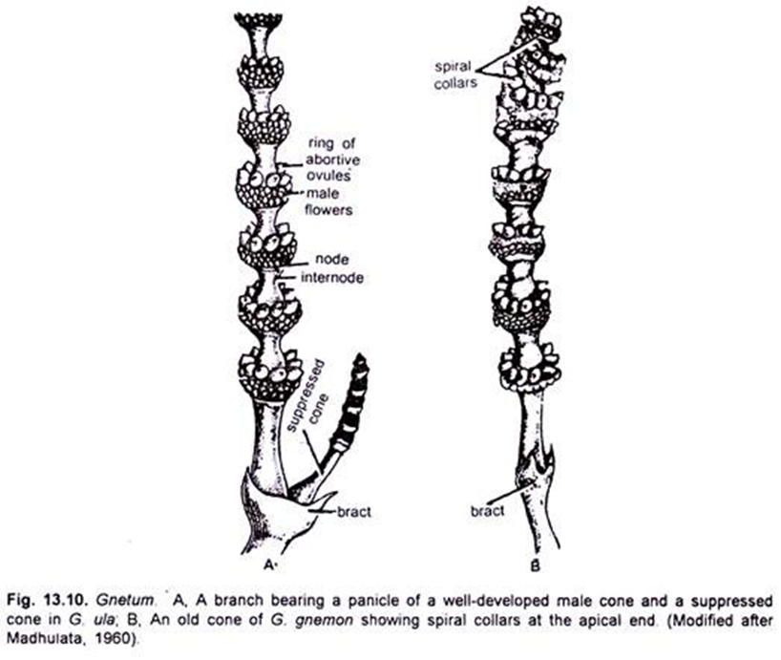

Slide 14
Male strobilus/cone
■ The male strobilus has a long slender axis. The male strobilus is branched and branching may be of several kinds. The axis bears 10-25 whorl of bracts (collars).
■ -About 12-25 male flowers are arranged in three to six rings above each collar.

Slide 15
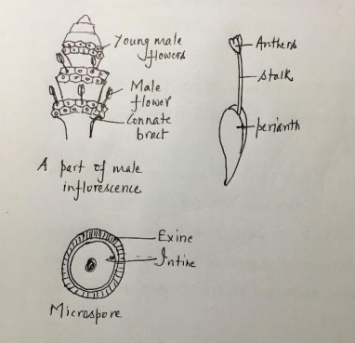
In each collar, there are three to six rings of 12-15 or more male flowers and a single ring of 7-15 imperfect female flowers or abortive ovules is present above male flowers.
■ A young strobilus is compact due to much reduced axis with very short internodes and the collars appears to be continuous.
■ Male flower:
■ A male flower has two unilocular anthers enclosed in a small sheathing perianth. Its stalk is called antherophore which elongates at maturity. Consequently, the anther emerges beyond the collar through a slit in the perianth. The number of anthers in a male flower may also vary.

Slide 16
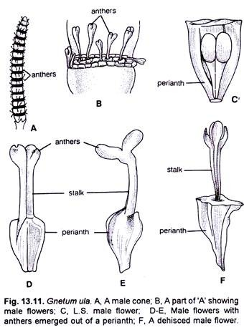

Slide 17
Microsporangium and microsporogenesis:
− Two groups of hypodermal archesporial cells form multicellular archesporium by repeated divisions.
− The outermost layer of the archesporial cells divides to form the primary parietal and the sporogenous cells.
− The parietal layer, by periclinal division, gives rise to a wall layer towards outside and tapetum towards inside.
− The tapetal cells become densely cytoplasmic and are normally binucleate (rarely multinucleate). The nuclei may fuse and become polyploidy. The tapetal cells start degenerating after meiosis.
− The sporogenous cells divide and increase in number, the last cell generation of which differentiates into microspore mother cells(2n).
− Broad cytoplasmic channels interconnect microspore mother cells or meiocytes forming a syncytium.

Slide 18
As the mother cells enter meiosis, it is surrounded by a thick layer of callose.
Meiosis results in the formation of decussate, tetrahedral or isobilateral tetrads of microspores(n) still embedded in the callose cover.
The callose covering is soon absorbed releasing individual haploid microspores.
The microspore/pollen wall has an outer thick exine with minute spines and an inner thin intine.

Slide 19
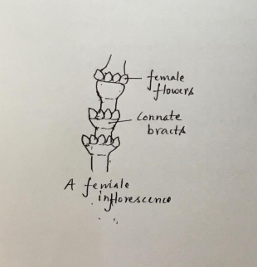
Female strobilus:
■ It is similar to the male strobilus in the young stages.
■ In a female strobilus, a ring of four to ten female flowers (ovules) is present above each collar.
■ There is a total absence of any male flowers. Initially all the ovules look alike, but layer only a few grow to maturity. The upper few collars lack ovules.

Slide 20
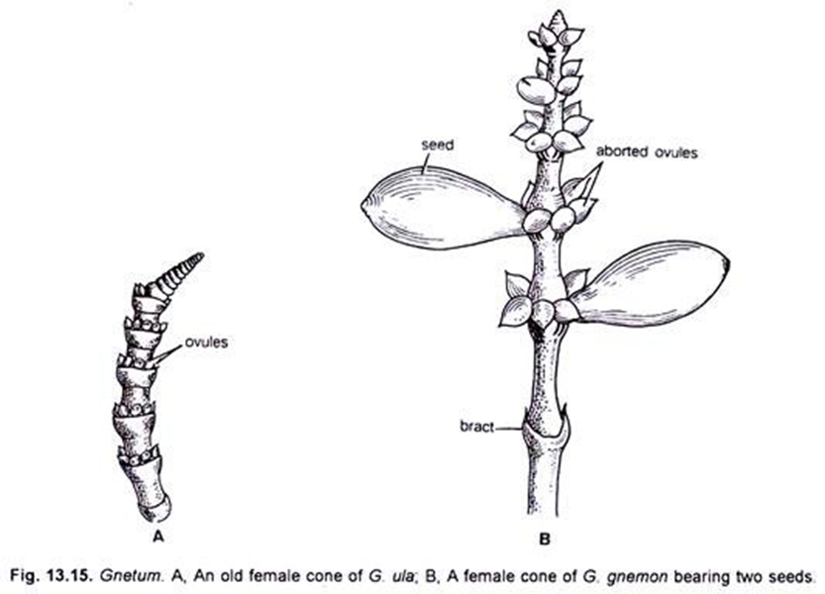

Slide 21
Megasporangium/ovule:
The integumented megasporangium is called ovule. The ovule is stalked in G. ula, but may be subsessile or even sessile.
The ovules are orthotropous, crassinucellate and are protected by three envelopes.
The outer envelope is thick and succulent at maturity. It is considered to be the perianth.
The middle and the inner envelopes are actually the integuments. The middle envelop is called the outer integument which is anatomically similar to the outer envelope.
The inner envelope, i.e., the inner integument, elongates for beyond the apical cleft of the perianth and forms a long micropylar tube or the socalled ‘style’. The inner integument is free from the nucellus except at the chalazal end. Two sets of vascular bundles are formed which the outer integument and the other to the inner integument.

Slide 22
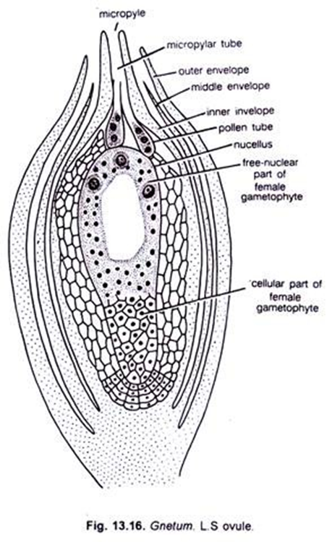

Slide 23
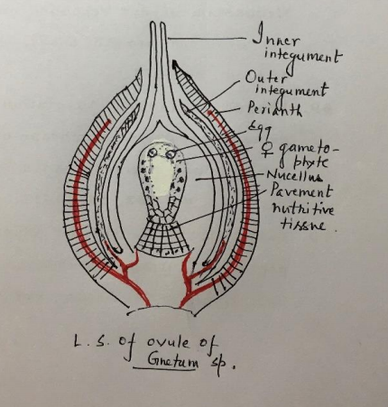

Slide 24
The nucellus is well developed and quite massive. Its epidermis divides, forming a nucellar cap. There is a clear demarcation between the nucellar cap and the parietal tissue. Prior to meiosis in the megaspore mother cells, some nucellar cells below them divide to form a tissue wherein cells are arranged in radiating rows. This is termed as the pavement tissue. This tissue is nutritive in function. With growth of the female gametophyte the pavement tissue gets absorbed and obliterated.

Slide 25
Gametophyte of Gnetum

Slide 26
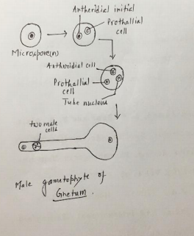
Male gametophyte
■ Development of male gametophyte before pollination
■ The microspore nucleus divides to form a small lens shaped prothallial cell and a large antheridial initial
■ The prothallial cells rounds up and does not undergo any further division.
■ The antheridial initial divides forming an antheridial cell and a tube cell. Since a stalk cell is not formed in Gnetum, the antheridial cell directly functions as a spermatogenous cell.
■ At the three celled stage the pollens are shed. (one prothallial cell, an antheridial or spermatogenous cell and a tube nucleus).

Slide 27
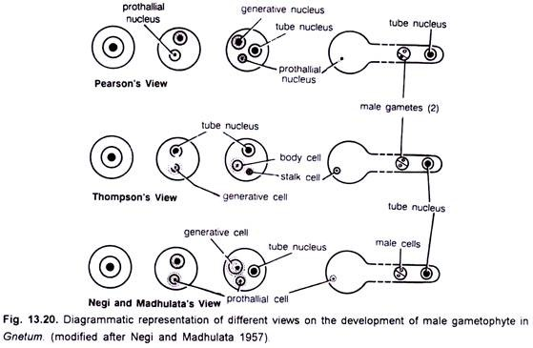

Slide 28
Different views regarding development of male gametophyte:
Thompson (1916) opined that the prothallial cell does not form at all in the male gametophyte (Fig. 13.20, Middle). The microspore nucleus divides into a tube nucleus and a generative cell. The latter divides into a stalk cell and body cell. The tube nucleus and body cell enter in the pollen tube where the body cell divides into two equal male gametes.
According to Negi and Madhulata (1957) the microspore nucleus in Gnetum gnemon and G. ula divides into a small lenticular cell and a large cell (Fig. 13.20, Lower). The lenticular cell does not take part in the further development and ultimately disappears.

Slide 29
Female gametophyte and Megasporogenesis
Two to four hypodermal cells in the nucellar tissue at the micropylar end is differentiated into primary parietal cells towards outside and the primary sporogenous cells.
Towards inside, the primary parietal cells together with nucellar epidermal cells divide repeatedly to produce a massive nucellus.
The primary sporogenous cells divide to form 8-20 sporogenous cells which are linearly arranged.
The sporogenous cells function as megaspore mother cells which undergo meiotic division.
Since no walls are laid down after meiotic division of megaspore mother cells, all the four megaspore nuclei remain within the mother cell to form a tetranucleate coenomegaspore. Thus, the female gametophyte of Gnetum is tetrasporic.
A pollen chamber develops at the apical portion of the nucellus after megasporogenesis is complete.

Slide 30
Flange: At the time of pollination, a circular rim or an umbrella shaped structure, called ‘flange’ develops from the integument just above the level of inner integument.
Micropylar closing tissue: Another tissue is formed by the proliferation of the inner epidermis of integument at the level of the flange. This results in the closure of the micropylar canal. The plugging tissue has been called ‘obturator.
Only 2 or 3 coenomegaspores grow, although several develop in the same nucellus.
There is a free nuclear division in the coenomegaspore, as a result a large number of free nuclei are formed. The number of nuclei may be 256 in G. gnemon, 512 in G. africanum and 1500 in G. ula.

Slide 31
Later, as divisions continue, the gametophyte in the upper part widens and contains a vacuole, whereas in its lower part the gametophyte shows accumulation of cytoplasm. With further growth, the gametophyte becomes elongated and acquires the shape of an inverted flask.
The gametophyte which, for most of its part, is free nuclear, starts becoming cellular in its upper portion soon after one of the eggs is fertilized.
Eventually the upper part of the gametophyte becomes almost cellular.
The important characteristic in the female gametophyte of Gnetum is the absence of archegonia.
One to three nuclei of the gametophyte in the micropylar end enlarge several times and accumulate dense cytoplasm around them. These large and densely cytoplasmic cells are the eggs.

Slide 32
Pollination
Development of male gametophyte before pollination
■ The pollen grains are shed at the three-nucleate stage.
■ The pollination drop, which is rich in sugar, is exuded at the top and collects pollen.
■ As the fluid dries, the pollen grains are sucked into the micropylar canal and lodge in the pollen chamber.
■ Ants are known to visit the pollination drop which is formed by the degenerated cells of the nucellar tip

Slide 33
Development of male gametophyte after pollination:
■ The exine is casts off during pollen germination.
■ The tube cell of the pollen comes out in the form of a pollen tube which traverses the nucellus through intercellular spaces. ■ The prothallial cell remains within the pollen grain and eventually disorganizes.
■ The spermatogenous cell moves into the pollen tube and subsequently it divides to form two equal (e.g., G. ula, G. gnemon) or unequal (e.g., G. africanum) male cells just prior to fertilization. The male gametes move ahead of the tube nucleus and come to lie near the tip of the pollen tube.
■ The male cells are actually the male gametes which are non-motile.

Slide 34
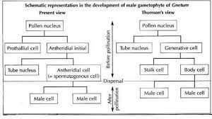

Slide 35
Fertilization
The fertilization in Gnetum has been studied only by a few workers. Vasil (1959) studied this phenomenon in G. ula. At the time of fertilization, the pollen tube pierces through the membrane of the female gametophyte just near to a group of densely cytoplasmic cells. The tip of pollen tube bursts and the male cells are released. One of the male cells enters the egg cell.
The male and female nuclei, after lying side by side for some time, fuse with each other and form the zygote. According to Swamy (1973), the only identifying features of the zygote are its spherical shape and dense cytoplasm. Both the male cells of a pollen tube may remain functional if two eggs are present close to the pollen tube.

Slide 36
Development of Endosperm Embryo Seed
Germination of Seed

Slide 37
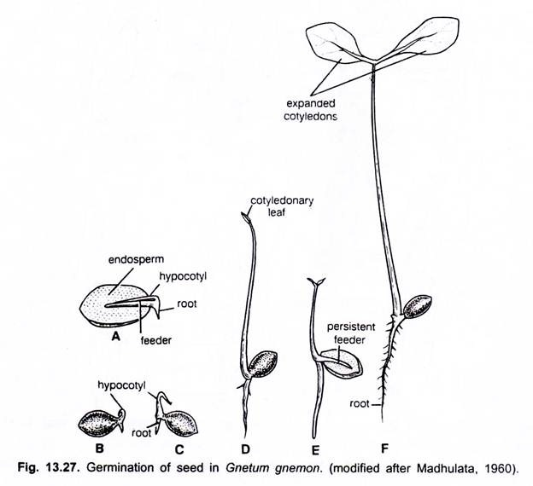

Slide 38
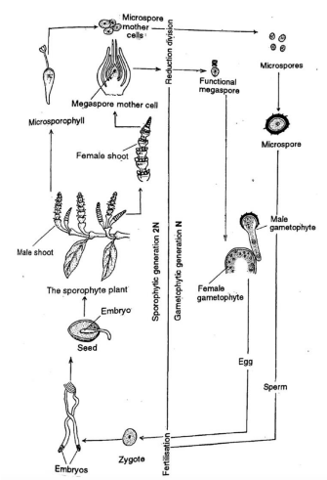
Life Cycle

Slide 39
THANKS

