Slide 1
Meristematic tissue ভাজক কলা
Pinaki Kr. Rabha

Slide 2
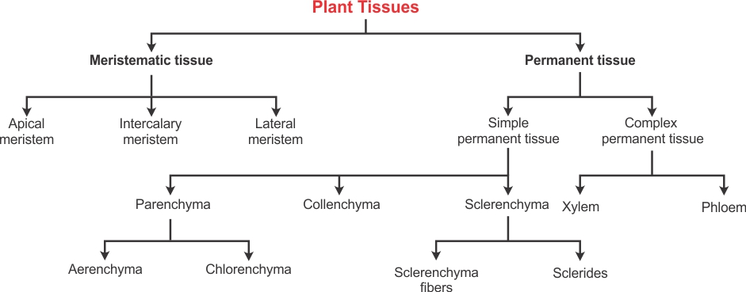

Slide 3
Meristematic tissue is group of immature cells that has capacity of division and redivision.
The term meristem was coined by Nageli (1858). Meristemsin plants are found in apex of stem, root, leaf primordia, vascular cambium, cork cambium, etc.

Slide 4
They are composed of immature cells.
Absence of intercellular spaces.
Cells are oval, rounded or polygonal in shape.
Cells are always living and thin walled.
Cells are rich in cytoplasm with minute vacuoles.
Cell is diploid and shows mitotic cell division.
Cell is devoid of reserve food materials, ER and plastids.

Slide 5
Function:
Meristems are actively dividing tissues of the plant.
They are responsible for primary (elongation) and secondary (thickness) growth of the plant.
All new organs and their growth occur by the division of meristematic tissue.
Secondary tissues such as, wood, cork are also formed due to activity of meristematic tissue.

Slide 6
Types of meristematic tissues:
A. Based on origin:
Promeristem: আদি ভাজক কলা
The earliest and youngest meristematic tissue.
It originates from the embryo.
Promeristem gives rise to primary meristem.
It is found in the root and the shoot tips.

Slide 7
2. Primary meristem: প্ৰাথমিক ভাজক কলা
Primary meristem are derived from promeristem. They are located below the promeristem at root, stem , leaves and other appendages. The cells of this region further divide to form permanent tissues.

Slide 8
3. Secondary meristem: গৌণ ভাজক কলা
Primary meristems gradually differentiate into permanent tissues. Some living permanent cells may regain the power of cell division. They consti­tute the secondary meristem, as they originate from permanent cells.
The cork cambium or phellogen, arising from epidermis, cortical and other cells during secondary increase in thickness, is an example of secondary meristem.

Slide 10
B. Based on the position on the plant body:
Apical meristem: অগ্ৰস্থ ভাজক কলা
Apical meristems occur at the apices of the stems, roots, main and lateral, of the vascular plants. Growth in length of the axis is entirely due to their activities; so they are also called growing points. The initiating cells may be solitary or in groups.
The apical meristem of the root and stem can be classified into three different regions-
dermatogen- the outermost layer single cell in thickness that gives rise to epidermis in stem and epiblema of the root.
Periblem- it gives rise to hypodermis, general cortex and endodermis in dicot whereas in monocot only cortex.
Plerome: it is the central region of the stem and is divided into pericycle, vascular bundles, pith and medullary rays.

Slide 12
2. Intercalary meristem: নিবেশিত ভাজক কলা
It is located in the leaves and internodes at the intercalary position.
These help to increase the length of the internode.
It is found in grass, monocots and pines.
It is a part of apical meristem and adds to the height of the plant.

Slide 13
3. Lateral meristem: পাৰ্শীয় ভাজক কলা
These meristems occur laterally in the axis, parallel to the sides of the organs in dicotyledons and gymnosperms. They are composed of initials which divide periclinally. The derivatives gradually differentiate into permanent tissues called secondary tissues.
These tissues are added to the existing ones and are responsible for increase in thickness. The growth in thickness thus secured due to addition of secondary tissues is referred to as secondary growth.

Slide 14
C. Based on function:
1. Protoderm
It is the outermost plant tissue and forms the epidermis.
It protects the plants from any mechanical shocks.
2. Procambium
It is the innermost tissue and gives rise to xylem and phloem.
It helps in the transport of water and nutrients to different parts of the plant.

Slide 15
3. Ground Meristem
The cells are large with thick walls.
It forms the cortex, pericycle and pith.

Slide 16
D. Based on plane on cell division:
Mass meristem: it exhibits division in all planes resulting in an increase in volume like the development of pith, cortex, endoderm, embryo, etc.
Rib meristem: cell division is only in one plane and results formation of row of cells to increase the length of the plane.
Plate meristem: cells divide in two planes and consequenty there is an increase in the area of the organ.

Slide 17
Questions and discussion

