Slide 1
PHYTOPHTHORA
Pinaki Kr. Rabha
J.N.College, Boko

Slide 2
It is one of most destructive plant pathogen.
It infects a number of angiospermic cultivated crops including potato, tomato, colocasia, areca nut, etc.
The fungus is responsible for destruction of potato crops in Ireland in 1840s resulting famine and death of over a million people.

Slide 3
Symptoms of the disease
The development of leaf rots or lesions varies with environmental conditions.
Leaf lesions begins as small, irregularly shaped, light green to grey spots.
In cool (20oC or less), moist environments, lesions expand rapidly to form a large black rots that spread the entire plants.

Slide 4
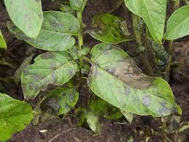

Slide 5
Infection on underground tubers is first seen in the form of dry rot and brown discolorations of the tissues.
In the later stages the infection spreads inwards, the entire tuber becomes brown and ultimately gets decayed.

Slide 6
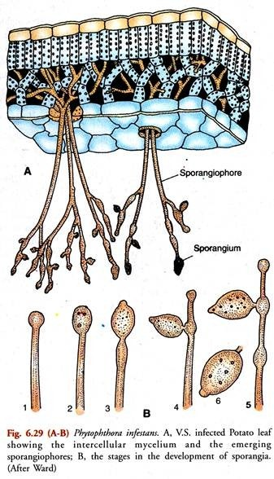

Slide 7
Somatic structure:
It is profusely branched and consists of aseptate, hyaline, coenocytic hyphae . The mycelia are both inter and intracellular.
Asexual reproduction:
Asexual reproduction is brought about by zoospores. They are produced within sporangium. Sporangiophores emerge from the lower surface of leaves through stomata and bear terminal, lemon shaped sporangia with distinct papilla. The renewed growth of the sprangiophore gives it a zigzag, sympodial shape.

Slide 8
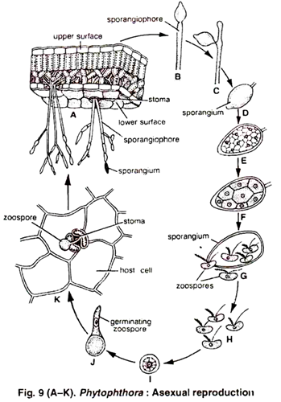
Asexual reproduction

Slide 9
Germination of sprangia:
The sprangia are disseminated by wind and soil water. The germination of sporangia depends upon temperature.
Indirect germination:
Low temperature favors for indirect germination of sporangia. The protoplasm of the sporangium divides into several uninucleate protoplasts. Each protoplast metamorphoses into a biflagellate, reniform, uninucleate zoospore. The sporangia bursts at the papilla and the zoospores are liberated. The liberated zoospores are deflagellated, then encyst and finally germinate to form a new hypha.

Slide 10
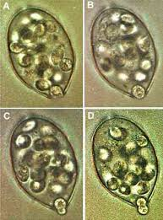
Sporangium

Slide 11
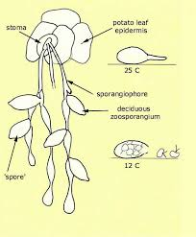
Asexual reproduction

Slide 12
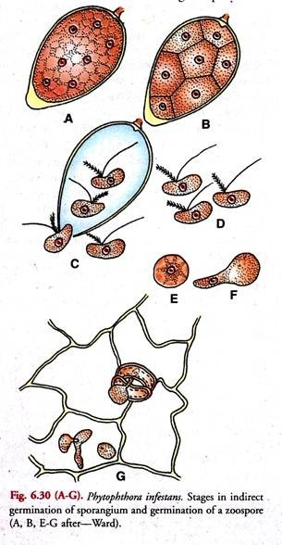

Slide 13
Direct germination:
In high temperature and dry conditions, the sporangia behaves like as conidia and germinate directly by forming multinucleate germ tube.

Slide 14
Sexual Reproduction
In Phytophthora sexual reproduction is oogamous. It is infrequent in P. infestans as it is a heterothallic species.
On the basis of the position of sex organs, the species of Phytophthora are designated as paragynous or amphigynous. In paragynous type (P. cactora), the sex organs lie laterally, while in the amphigynous type (P. infestans and P. colocasiae),the antheridia forms a funnel or coller shaped structure at the base at the oogonium.

Slide 15
The oogonium is initially multinucleate, at maturity contain a single nucleus. The protoplasm at the centre of the oogonium is called ooplasm, which contain the female nucleus and serve as female gamete.
The antheridium is club shaped. At maturity it contains a single male nucleus. The male nucleus reaches the ooplasm through a fertilization tube formed by the antherium.

Slide 16
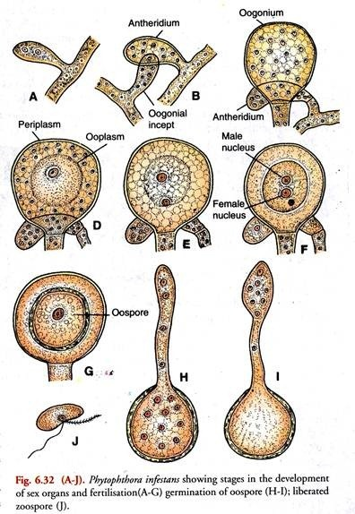

Slide 17
Plasmogamy followed the karyogamy, results in a diploid zygote nucleus. It is surrunded by a wall and converted into oospore. After a rest period, it germinates and forms a zoosporangium at the tip of the germ tube. Zoospores of two mating types are found in equal numbers, which give rise to thalli of opposite mating types.

Slide 18
Sexual reproduction

Slide 19
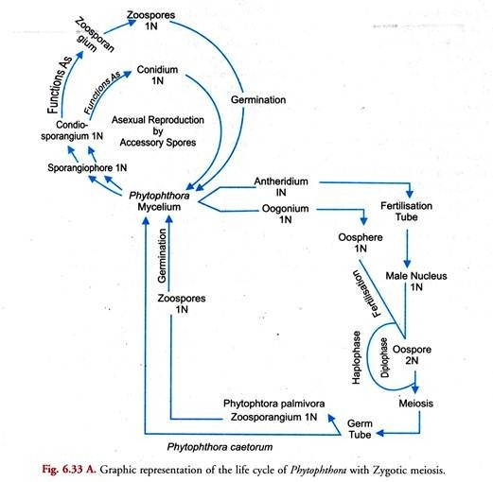

Slide 20
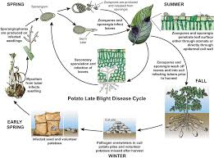
Life cycle

Slide 21
THANK YOU

