Slide 1
INTERFERENCE ON THIN FILM Lecture 7
Minati Barman
Associate Professor
Department of Physics
J N College, Boko

Slide 2
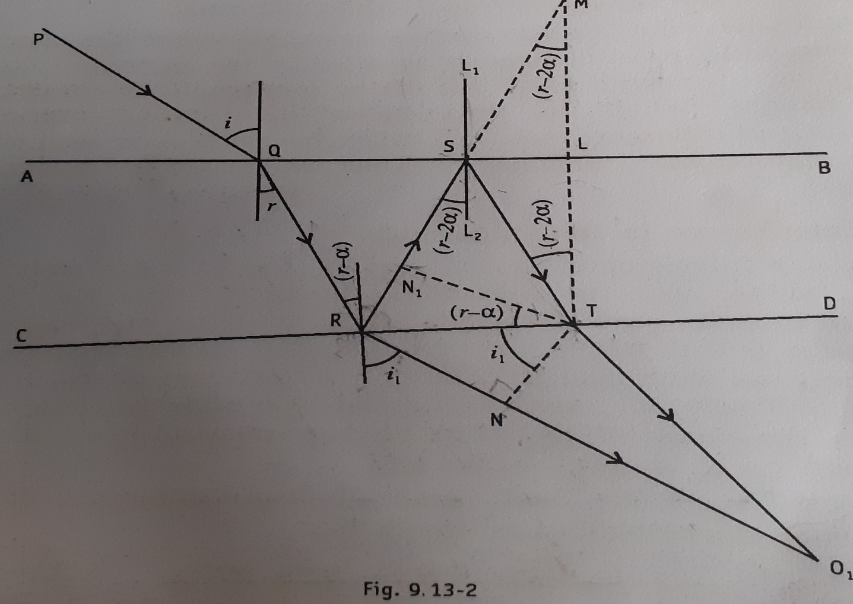
Interference on thin film for transmitted system:
α- angle between the two film.
Path difference between the two transmitted beam
l= n (RN₁+N₁S+ST)-RN
By Snell’s law
n=$\frac{\sin{i}}{sin⁡(r−α)}$ =$\frac{RN/RT}{RN₁/RT}$
RN = n.RN₁
l= n.(RN₁+N₁S+ST)-RN
= n.(N₁S+SM)= nN₁M
=2ndcos(r-$2α$)

Slide 3
For maxima or brightness
2ndcos(r-2$α)=2m\frac{λ }{2}$
$$=mλ$$
For minima or darkness
2ndcos(r-2𝛼)= (2𝑚+1)λ/2
When α=0, then condition of maxima in the transmitted system corresponds to the minima in the reflected system and vice versa.
Necessity of a broad source:
If the incident ray comes from a point source then the reflected or transmitted ray entering eyes are confined to a narrow field of view. But for a broad source the light waves coming from each point gives rise to a pair of coherent waves and field of view become wide and fringes are seen for entire film.

Slide 4
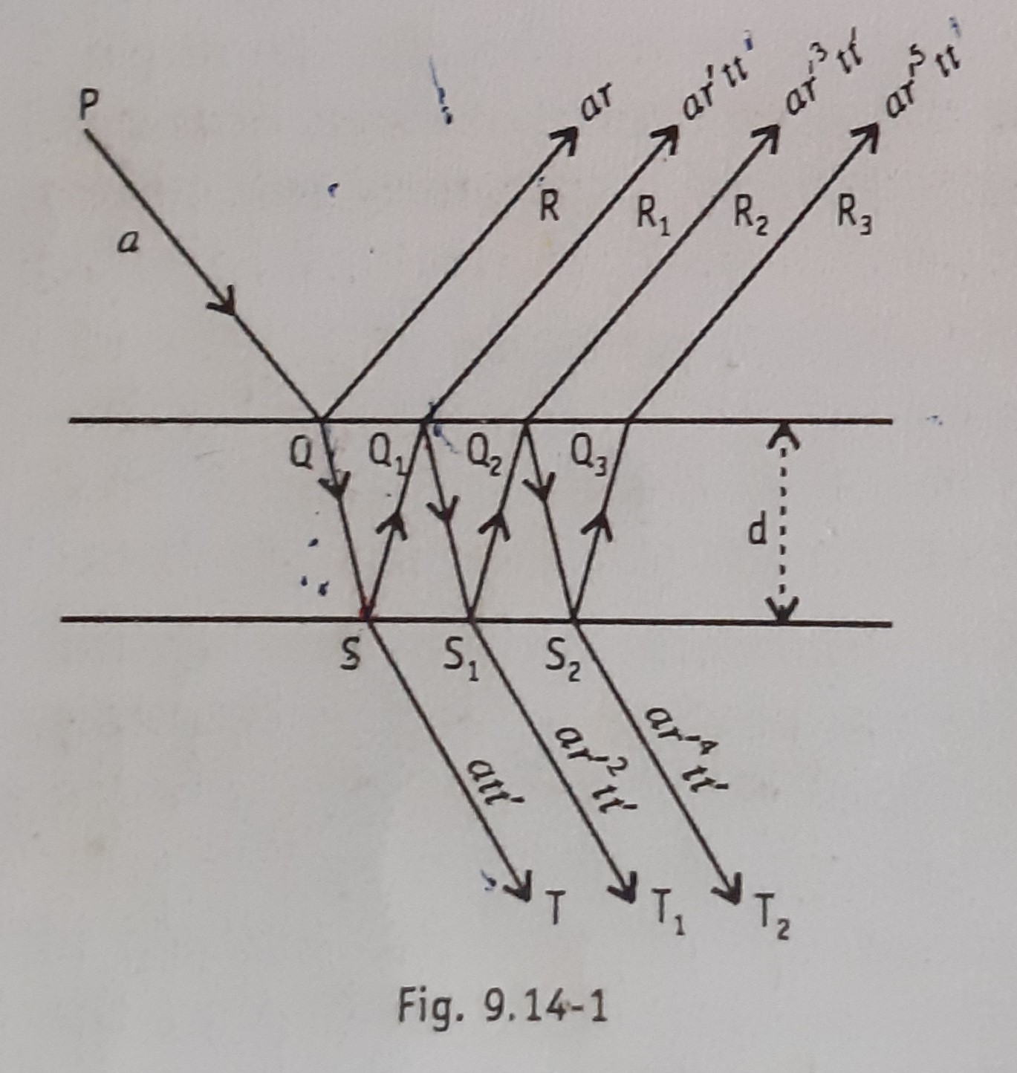
Infinitely thin film:
Here a –amplitude of the incident wave.
r-amplitude reflection coefficient of medium 1 (air)
r’- amplitude reflection coefficient of thin film medium
t -the amplitude transmission coefficient of medium of thin film.
t’- the amplitude transmission coefficient of air medium.

Slide 5
The resultant amplitude of the waves reflected along QR, Q₁R₁, Q₂R₂……………..and so on will be equal to
A= ar + ar’tt’(1+$r^{′}$²+$r^{′4}$+ ……..upto $∝$ )
=${ar+ar^{′}tt}^{′} .(\frac{1}{ 1−{r^{′}}^{2}} )$
Now from Stokes treatment tt’=1-r’² and r’=-r so A= ar-ar =0.
Thus when the film is very thin compared to the wavelength of light then it appears complete dark for the reflected system.
When the thickness of the film is very thin compared to the wavelength of light then geometrical path difference is negligible. Therefore resultant amplitude of the transmitted waves is

Slide 6
A’= att’+att’r’²+att’${r′}^{4}$+ …………………..
=att’(1+r’²+${r′}^{4}$+ ……………………)
=att’$\frac{1}{(1−r′²) }$
Science from Stokes treatment tt’=1-${r′}^{2},$so A= a . This implies that a very thin film transmits all the light to the other side of the film.
*******************

