Slide 1
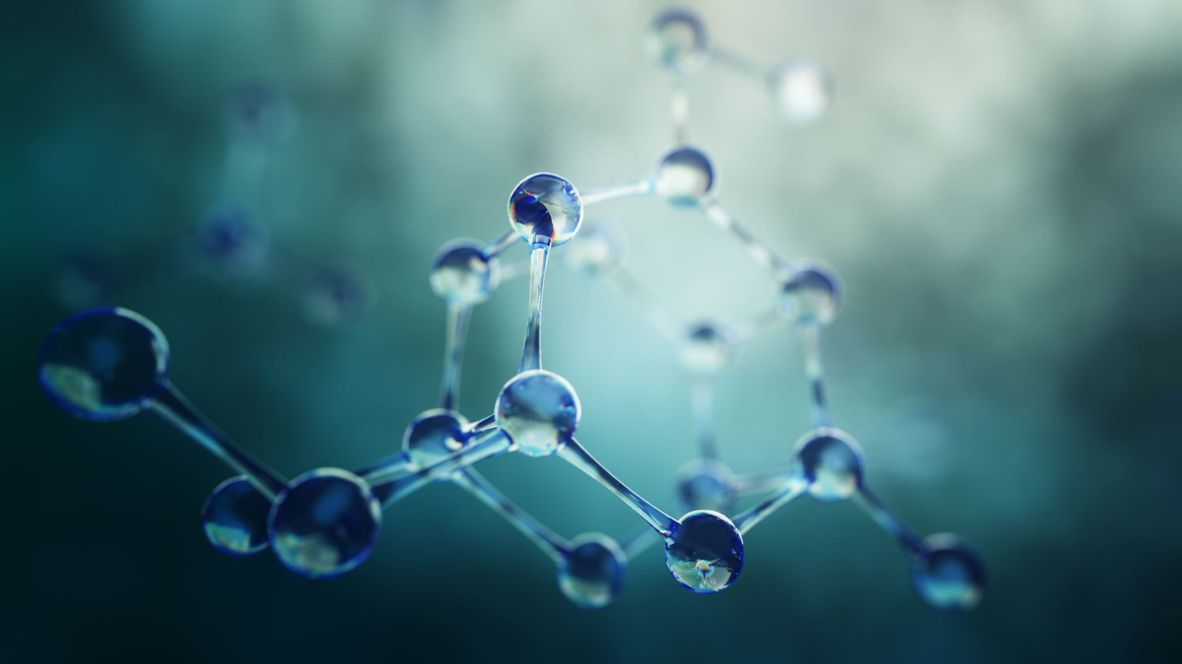
Nitrogen metabolism
Pinaki Kr. Rabha

Slide 2
Sources of Nitrogen:
Atmospheric nitrogen
Ammonium compound
Nitrate
Organic nitrogen

Slide 3
Nitrogen cycle
Steps:
Nitrogen fixation
Ammonification
Nitrification
Denitrification

Slide 5
Nitrogen fixation
Conversion of atmospheric nitrogen into ammonia is called nitrogen fixation.
Physical nitrogen fixation: 5%
Biological nitrogen fixation: 95%

Slide 7
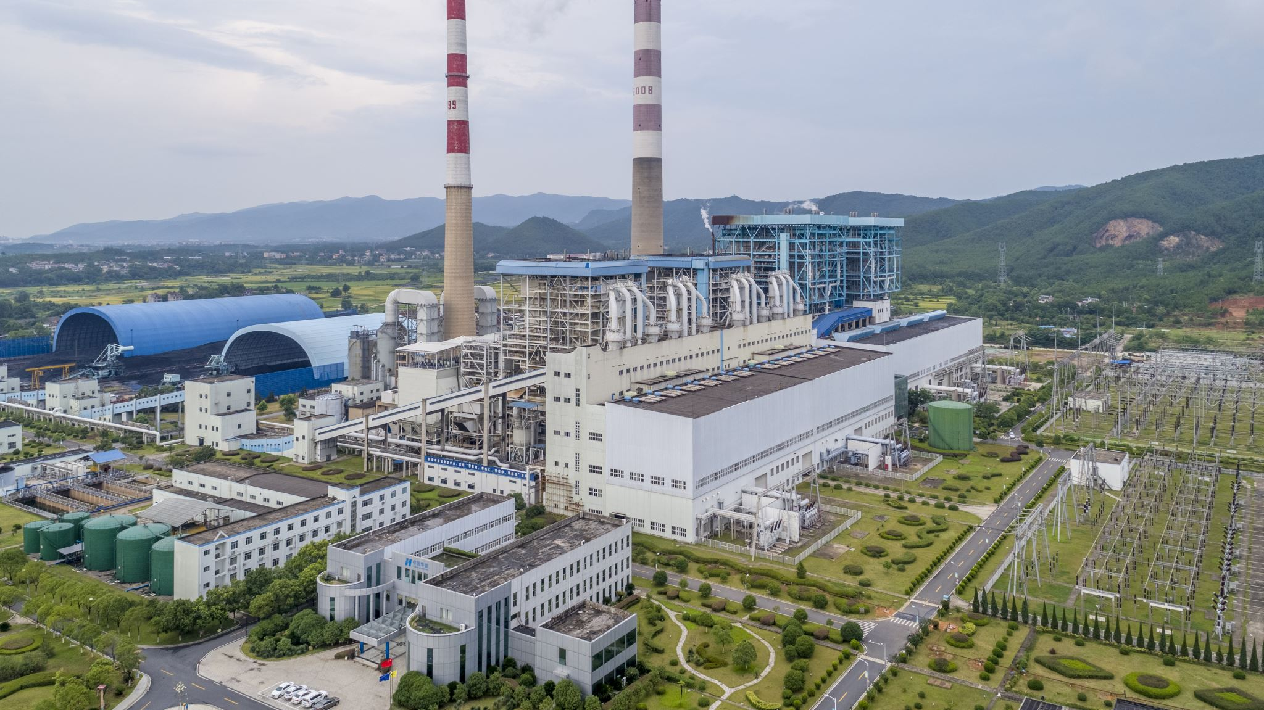
In physico-chemical process, the atmospheric nitrogen combines with oxygen during lightning or electrical discharges in the clouds and produces different nitrogen oxides. These nitrogen oxides get dissolved in rain water, and on reaching earth surface they react with mineral compounds to form nitrates and other nitrogenous compounds.

Slide 8
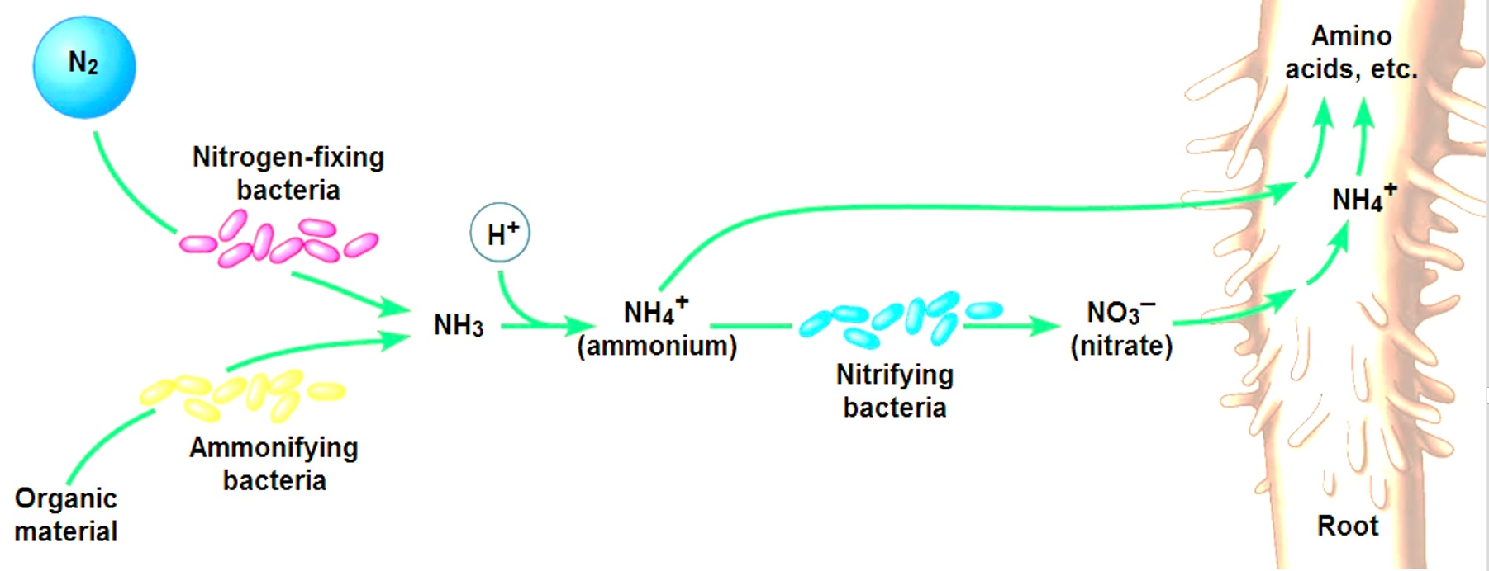
Biological nitrogen fixation:
Free living:
Symbiotic

Slide 9
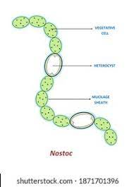
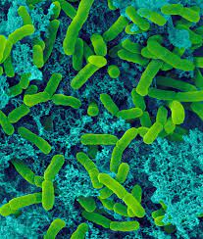
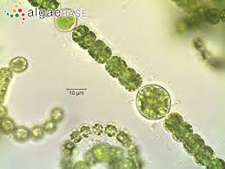
Free living nitrogen fixer

Slide 10
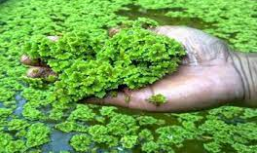
Symbiotic nitrogen fixer

Slide 11
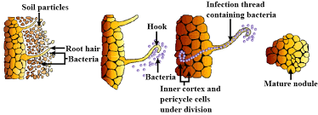
Recognition of host
↓
Colonization of Rhizobium around root hair
↓
Release of nod factor &Curling reaction of root hair
↓
Development of infection thread
↓
Passage of rhizobia through infection thread
↓
Release of rhizobia in the cortical cells of the root
↓
Stimulate to divide
↓
Formation of root nodule

Slide 12
Ammonification:
Ammonia which combines to organic acids to form amino acids. Amino acids are used in the synthesis of proteins, enzymes, chlorophylls, nucleic acids, etc.
Animals derive their nitrogen requirement from the plant proteins.
The dead organic remains of plants and animals and excreta of animals are acted upon by a number of microorganisms, especially actinomycetes and bacilli, such as Bacillus ramosus, B. vulgaris, etc. These organisms utilise organic compounds in their metabolism and release ammonia. This process is called ammonification. After meeting their own metabolic requirement, these microbes release the excess ammonia in the soil.

Slide 13
Nitrification
In next step of ammonia formation, ammonia is converted into nitrate by a group of chemo- autotrophic bacteria through a two-step process called nitrification.
Certain bacteria such as Nitrosomonas, Nitrococcus and Nitrospira in oceans and soils convert ammonia into nitrites and then nitrites into nitrates. These bacteria primarily use the energy of dead organic matter in their metabolism.
2NH3+ 3O2→2NO2+2H+2H2O
Conversion of nitrites to nitrates is brought about by several microbes, such as Penicillium (a fungus), Nitrobacter, etc.
2NO2+O2→2NO3

Slide 14
Denitrification
Ammonia and nitrates are converted into free nitrogen by certain microbes. This process is referred to as denitriflcation. Pseudomonas, the most common denitrifying bacterium. Denitrifying bacteria transform nitrate nitrogen to nitrous and nitric oxides, and ultimately to gaseous nitrogen, which goes to atmosphere.

