Slide 1
Synchytrium
Pinaki Kr. Rabha

Slide 2
Synchytrium endobioticum is an obligate parasite of potatoes causing the black wart diseases. In India the disease is found in Darjeeling district and its surroundings. This is common disease of potato in UK and other European countries.

Slide 3
Vegetative Structure:
The fungus is Unicellular.
The thallus is endobiotic and holocarpic.
Monocentric thallus body.

Slide 4
Symptoms of Black Wart Disease of Potato
Usually, the disease affects the underground parts of the host.
Diseased potato tubers appear as brown or black cauliflower like outgrowths.
The fungus cause the enlargement of the surface cells (hypertrophy) as well as increased the numbers of cells (hyperplasia) in the infected potato tuber, converting them into useless masses of watery tissue.
Most of the host cells contain resting sporangia.
Galls or tumors may be formed on aerial parts (stems and leaves).

Slide 5
Asexual reproduction
Prosorus:
In the spring season large number of uniflagellate zoospores are released from the infected parts. These zoospores penetrate the host tissues. Its flagellum left outside. The zoospores is uninucleate and amoeboid in shape. It absorbs food from the surrounding protoplast and increases in size. Its nucleus also increase in size and the entire structure gets surrounded by a golden brown thick wall. It is now called prosorus.
Uniflagellate zoospore→deflagellated →penetrate host tissues→surrounded by golden brown thick wall→Prosorus .

Slide 6
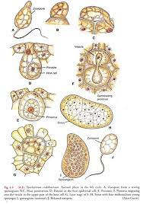

Slide 7
Germination of prosorus:
The mature prosorus starts germinating within the dead host cells. Its nucleus undergoes repeated mitotic divisions to form as much as 32 nuclei. At this stage the entire multinucleate prosorus gets divided into 4-9 multinucleate chambers with the help of thin hyaline walls. The nuclei in all these multinucleate chambers keep on dividing repeatedly to form as many as 200-300 nuclei. Each of such multinucleate chamber represents a sporangium. The group of sporangia is called a sorus.
Division of nucleus→ formation of 32 daughter nuclei→ cleavage of prosorus into 4-9 chambers → nuclei of each chamber divided to form 200-300 nuclei→ each chamber is termed as sporangium.

Slide 8
All these nuclei get surrounded by dense cytoplasmic contents. They develop into uninucleate and uniflagellate zoospores if water is in abundance. But if there is scarcity of water, these uniflagellate bodies are released and function as gametes.
The released uninucleate and uniflagellate zoospores keep on swimming in the film of water in the soil. They may reinfect the same host and thus again repeat all the same process. Thus, the asexual cycle is completed.

Slide 9
Sexual reproduction
Gametangia:
Under conditions of absence of water (dry weather), the segments of the prosorus act as gametangia which are in no way different from sporangia. The gametangia produce planogametes. Gametes produced in different gametangia fuse to form a bigger biflagellate zygote cell.

Slide 10
Zygote: The zygote swims for some time and encysts on the surface of the host epidermis and pene­trates the host cell by a process similar to zoospore penetration. It induces uncontrolled cell division in the adjoining cells. Consequently, the infected cell is soon buried deep in the host tissue.
Planogamete + planogamete = zygote → encyst → penetrate host tissue→ induces cell divisions →hyperplasia.

Slide 11
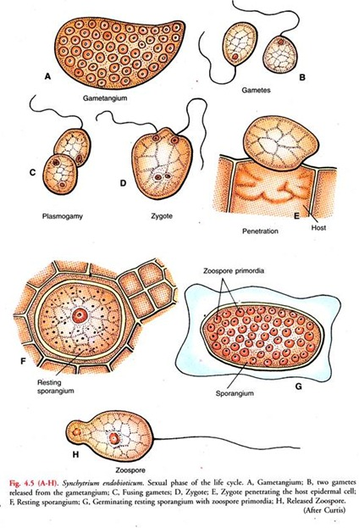

Slide 12
Resting Sporangium: The diploid fungus grows, develops a thick, two layered wall and transforms into a resting sporangium.
The resting sporangia are released into the soil after decaying the host tissue and are capa­ble to germinate within about two months.
Germination of resting Sporangium: With the onset of favorable condition i.e., in spring season, the resting sporangium becomes active and its nucleus undergoes meiotic division followed by ordinary mitotic division resulting formation of a number of daughter nuclei. The protoplast, along with a single nucleus, divides into many uni­nucleate segments.
After absorbing water, the wall of resting sporangium bursts open and releases the zoospores. The zoospores are like the asexual zoospores, which on coming in contact with a suitable host cause infection and repeat the cycle again.

Slide 13
