Slide 1
PATTERNS OF BEHAVIOUR
6TH SEMESTER
ZOOLOGY(MAJOR)
REKHA CHETRY
DEPARTMENT OF ZOOLOGY
J.N.COLLEGE,
BOKO,ASSAM,INDIA
Email:chetryrekha@gmail.com

Slide 2
PATTERNS OF BEHAVIOUR
BEHAVIOUR:
Behaviour is what an animal does and how it does .
Anything an animal does in response to a stimulus in its environment.
All those processes by which an animal senses the external world and adopts itself to the environment
BEHAVIOUR PATTERN:
A behaviour pattern may be defined as a segment of behaviour which has a specific adaptive function.
There are millions of different species of animals and each species behaves somewhat differently. However, there are common patterns of behaviour exhibited by many species and a few behaviour patterns that are exhibited by all species
BEHAVIOURS are either Innate or learned

Slide 3
PATTERNS OF BEHAVIOUR
INNATE BEHAVIOUR
LEARNED BEHAVIOUR
Hard wired
Instinctual
Genetically determined
Example: Kinesis, Reflex,
Taxis , FAP
BEHAVIOUR results from both gene and environment
Flexible
Not genetically determined

Slide 4
PATTERNS OF BEHAVIOUR
According to Odum(1971) there are six major patterns of behaviour ‘ These are –
Tropism
Taxis
Reflexes
Instinct
Learning
Reasoning
Importance of behaviour patterns vary according to the species.
Out of these six behavioural patterns tropism is restricted to direction movement or orientation in organisms such as plants that lack nervous system.

Slide 5
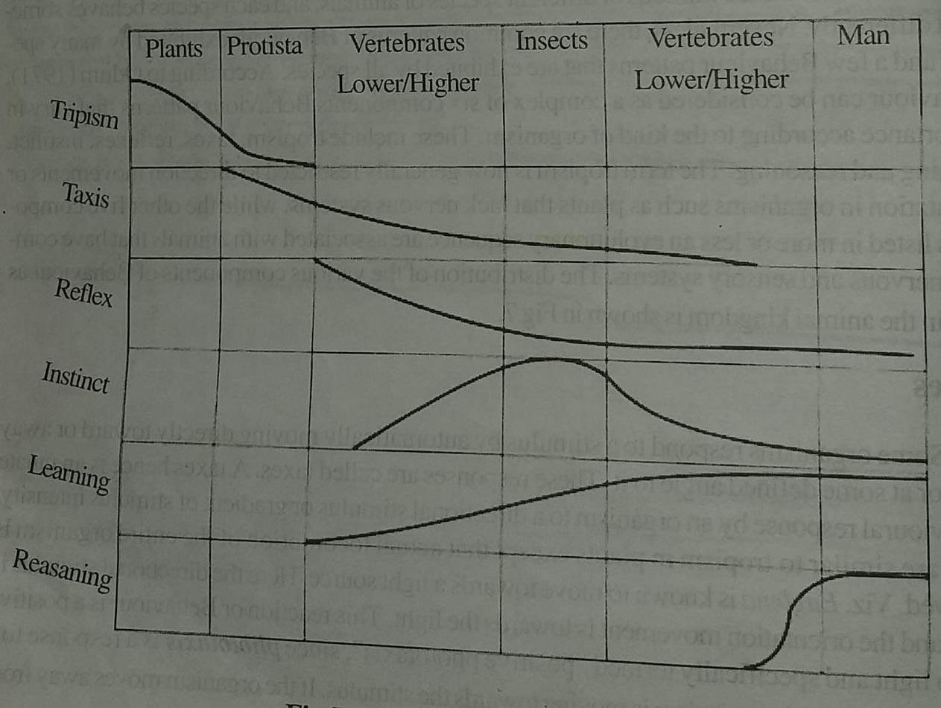
PATTERNS OF BEHAVIOUR
Distribution of various behaviour patterns in Animal kingdom.

Slide 6
PATTERNS OF BEHAVIOUR
TAXIS
A taxis from ancient Greek meaning arrangement.
A taxis is an innate behavioural response by an organism to a directional stimulus or gradient of stimulus intensity.
Depending upon the orientation of an organism towards or away from the directional stimulus the taxis may be positive or negative.
Types of taxes
Based upon the stimulus 13 types of taxes have been identified

Slide 7
PATTERNS OF BEHAVIOUR
TAXIS
Phototaxis( stimulation by light), aerotaxis (oxygen), anemotaxis(wind), bartotaxis( pressure), chemotaxis( chemicals), gravitaxis( gravity), galvanotaxis( electric current), hydrotaxis( moisture), magnetotaxis( magnetic field), thermotaxis ( temperature change), thigmotaxis( physical contact) , menotaxis( light compass response) and rheotaxis ( response to current of water or air).

Slide 8
PATTERNS OF BEHAVIOUR
TAXIS
Depending on the type of sensory organs involved , taxis can be classified as
Klinotaxis: where an organisms continuously samples the environment to determine the direction of a stimulus.
Tropotaxis: where bilateral sense organs are used to determine the stimulus direction.
Telotaxis: Similar to tropotaxis but here single organ suffices to establish the orientation movement .

Slide 9
PATTERNS OF BEHAVIOUR
REFLEX
The word reflex is derived from Latin reflexus meaning reflection.
Simplest form of innate behaviour.
A reflex is an automatic response no conscious control.
A reflex is an automatic response to a stimulus .Simple reflexes produce rapid involuntary responses to a stimulus. This ensures that an animal respond in the way most likely to result in its survival. Simple animals use reflex action for the majority of their behaviour. The more complex animals such as humans only use reflex action in some of their behaviour.
There are two types of reflexes
Tonic reflexes: They are slow long lasting adjustment that maintain muscle tone, posture and equilibrium.
Phasic reflexes: They are quick short lived adjust,ment found in flexure responses.

Slide 10
PATTERNS OF BEHAVIOUR
REFLEX
Reflex action: When the safety of an organism demands a very quick response the signals may be passed directly from a sensory neuron to a motor neuron for instant unthinking action. This is reflex action.
Reflex arc:The anatomical pathway of a reflex is called the reflex arc. It is the nerve pathway which make fast automatic response possible. It consists of an afferent or sensory nerve, one or more interneurons within the central nervous system and an efferent ( motor, secretory or secreto-motor) nerve.
.

Slide 11
PATTERNS OF BEHAVIOUR
REFLEX
Examples of reflex:
Human can control the size of the eye’s pupil in response to light.
Pulling hand back from hot object..
Types of reflexes: Generally there are two types of reflexes-
Tonic reflexes: They are slow long lasting adjustments that maintain muscle tone , posture and equilibrium.
Phasic reflexes: They are quick , short lived adjustments found in flexure response

Slide 12
PATTERNS OF BEHAVIOUR
INSTINCTS
Any behaviour is instinctive if it is performed without being based upon prior experience and it is therefore an expression of innate biological factors.
Instincts are complex behaviour patterns which like reflexes are inborn, rather inflexible and valuable in adapting the animal to its environment.
They differ from reflexes in their complexity . While reflex is a simple response of an organism to specific stimulus , instincts in contrast are inborn complex pattern of behaviour that must exist in every members of the species and that cannot be overcome by force or will. The entire body participates in instinctive behaviour and an elaborate series of action may be involved. Instincts are inherited just as the structure of tissues and organs.

Slide 13
PATTERNS OF BEHAVIOUR
INSTINCTS
Examples:
The scratching behaviour of dog and European Bullfinch is a part of their genetic heritage.
Spider spinning webs .
The widespread behaviour of scratching with hind limb crossed over a fore limb is common to most birds , reptiles and mammals.

Slide 14
PATTERNS OF BEHAVIOUR
Learning :
Learning is any relatively permanent changes in response that occurs as a result of experience. Learning is characterized by persistent and measurable changes in behaviour which are not associated wit fatigue , altered motivation. Some information or knowledge is acquired and is then used to alter the individual’s actins or responses. Learning as an adaptive behaviour allows individuals to adapt to specific environment challenges. Learning allows animals to use information about the world to tailor their responses to environmental change.
Invertebrates such as flies , slugs and ants show an advanced form of learning when avoiding stimuli that have elicited pain responses.
Baboons have been trained to self inject psychotropic drugs which , it is presumed , improve their quality of life .

Slide 15
PATTERNS OF BEHAVIOUR
REASONING
Reasoning is the ability to solve complex problems by behaving according to general principles rather than simply responding to the situation with simple trial and error behaviour or modification of stimulus response behaviour. The animal should be able to put together elements from its past experience into new arrangements to meet different situations. Only in higher primates and man does reasoning involving problem solving and formulation of concept become a major component of behaviour.

Slide 16
PATTERNS OF BEHAVIOUR
FIXED ACTION PATTERN
Fixed Action Pattern( FAP): it is a sequence of unlearned innate behaviour that is unchangeable. It is a response of coordinated movements that are performed together as a unit without interruption. Each FAP is triggered by a unique stimulus variously known as sign stimulus , a key stimulus or a releaser. Once initiated it is usually carried to completion.
. A praying mantis striking at prey is a typical example. The releaser for this FAP is any movement by a small object within striking distance . Once initiated the mantis cannot change the direction in mid strike or abort the mission if the prey escapes.
Other common examples of FAP includes courtship displays, hunting or food gathering , nest building activities and attack or escape movements.

Slide 17
THANK YOU
STAY AT HOME & STAY SAFE

