Slide 1
Matter waves Group velocity and phase velocity
Minati Barman
Associate Professor
Department of physics

Slide 2
Contents:
Two slits experiment of electrons
Velocity of the de Broglie’s wave
Wave packet
Phase velocity
Group velocity

Slide 3
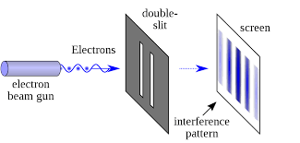
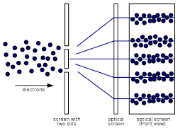
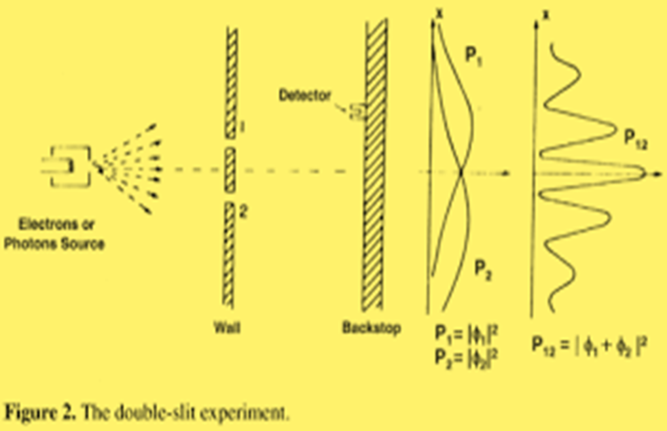
Electrons two slits experiment:
Photons or particles of matter (like an electron) produce a wave pattern when two slits are used

Slide 4
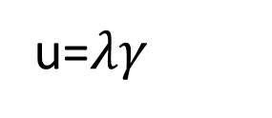
Velocity of the de Broglie wave:
Let u be the velocity of the de Broglie wave
-----------------------(1)
From Plancks relation
$γ=\frac{E}{h}$ ---------------------(2)
From de Broglie relation we have
λ = $\frac{h}{p}$ ---------------------(3)
$∴$ u =$\frac{E}{p}$
Since a particle of mass m moving with velocity v possess energy E= m$c^{2}$ and p=mv. Therefore
u= $\frac{{mc}^{2}}{mv}$= $\frac{c^{2}}{v}$ =c($\frac{c}{v}$)
u=$λγ$

Slide 5
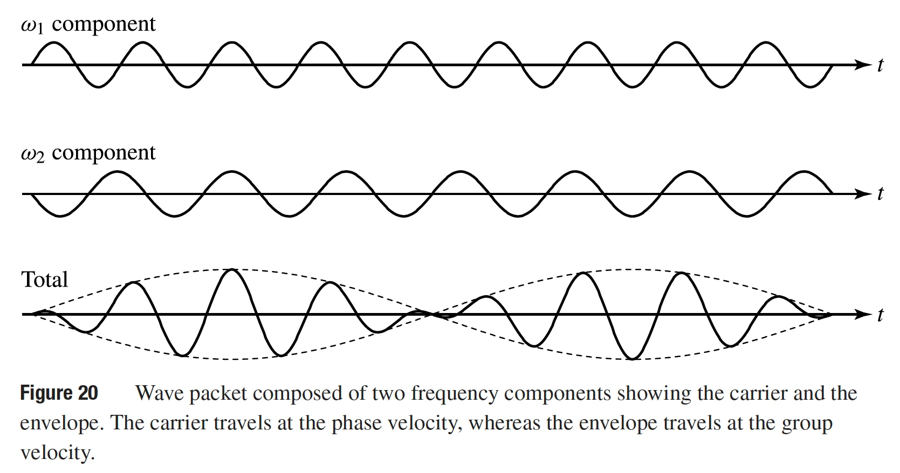
This shows that u>>c which is impossible according to Einsteins theory.
This problem was resolved by Schrodinger. He postulated that a moving particle is associated with a group of waves which travel together in the form of a wave packet. The velocity of the wave packet is called as group velocity $v_{g}$ $which is equal to particle velocity$(v)
Wave description of particle by wave packet

Slide 6
Phase velocity:
The phase velocity of wave is the velocity with which a definite phase of the wave, such as its crest and trough propagates through a medium.
Group velocity:
When two or more waves with slightly different frequency and velocity propagate through a medium and superimpose on each other then a wave packet is formed. Velocity with which the entire group of waves i.e the wave packet travels is called as group velocity.

