Slide 1
Microbes in human welfare
Pinaki Kr. Rabha

Slide 2
Microbes in household product
Curd
Butter milk
Cheese
Dosa and idli
Bread
Others

Slide 4
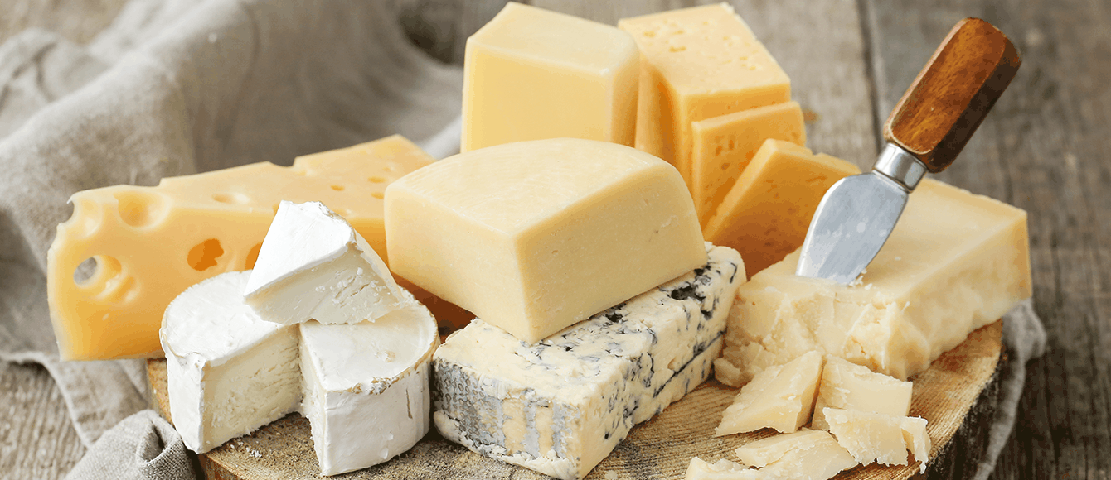

Slide 8
Microbes in industry
Fermented beverages
Antibiotics
Enzymes
Vitamins
Organic acids
Cyclosporin-A-from Trichoderma polysporum, used as immunosuppressive agent.
Stanins-from Monascus purpureus, lower down blood cholesterol.

Slide 9
Alcoholic fermentation

Slide 10
Fermented beverages:
Alcoholic beverages:
Undistilled- cider, beer, red wine, champagne, sherry, toddy, etc.
Distilled- gin, brandy, whisky, rum, vodka, etc.
Non-alcoholic beverages- curing of coffee beans, tea leaves.

Slide 11
Fermented beverages:
Alcoholic beverages:
Undistilled- cider, beer, red wine, champagne, sherry, toddy, etc.
Distilled- gin, brandy, whisky, rum, vodka, etc.
Non-alcoholic beverages- curing of coffee beans, tea leaves.

Slide 12
Production of antibiotics:
Antibiotics are chemical substances produced by certain microbes which in low concentrations are antagonistic to the growth of other microorganisms.

Slide 13
First antibiotic to be discovered was penicillin and was discovered by Alexander Flemming(1928) while working on Staphylococci . Penicillin is regarded as wonder drug.

Slide 14
Enzymes: Though the enzymes operate in biological systems, many of them are found to play important roles in industries. Some of them are:
Proteases- used in leather industries in bathing of hides, in textile industry for removing proteinaceous strains, in silk industry to liberate the silk fibers, in dry-cleaning industry for removing food spots, etc.
Amylases- used to remove starch from woven cloth, in brewing industry, clearing of turgidity in the manufacture of corn and chocolate syrups, softening and sweetening of bread, etc.
Others-lipase, pectinase, cellulase, streptokinase, etc.

Slide 15
Vitamins:
Vitamin B12 (Cabalamine) & Vitamin B2 ( Riboflavin).
Organic acids:
Citric acid: Aspergillus niger
Acetic acid: Acetobacter aceti
Lactic acid: Lactobacillus bulgaricus.

Slide 16
Vitamins:
Vitamin B12 (Cabalamine) & Vitamin B2 ( Riboflavin).
Organic acids:
Citric acid: Aspergillus niger
Acetic acid: Acetobacter aceti
Lactic acid: Lactobacillus bulgaricus.

Slide 17
Microbes in production of biogas
Biogas is mixture of gases produced from degradable organic matter by the activity of various anaerobic bacteria.
Composition:
Methane : 50-68 percent
Carbon dioxide:25-35%
Hydrogen :1-5%
Nitrogen: 2-7%
Oxygen: 0-0.1%
Microorganisms involved:
Methanobacterium, methanococcus, methanospirillum, etc

Slide 18
Microbes as biopesticides
Viruses as biopesticides- baculoviruses that has two genera
i. nucleopolyhedrovirus NPV, ii. Granuloviruses GV
2. Bacteria as biopesticides- Bacillus thuringiensis, Trichoderma , Beauveria bassiana, etc.

Slide 19
Microbes as biofertilizers:
Bacteria as nitrogen fixers
Legume- Rhizobium symbiosis
Free living bacteria- Azotobacter, Closteridium, Bacillus polymyxa, etc.
2. Cyanobacterial as nitrogen fixers
3. Mycorrhizae

Slide 20
Microbes as biofertilizers:
Bacteria as nitrogen fixers
Legume- Rhizobium symbiosis
Free living bacteria- Azotobacter, Closteridium, Bacillus polymyxa, etc.

Slide 21
Cyanobacterial as nitrogen fixers
Free living
Symbiosis

Slide 22
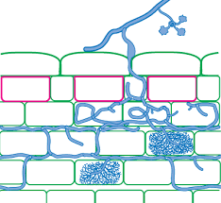
3. Mycorrhizae

Slide 23
Microbes in sewage treatment:
Sewage is the municipal waste water.
1. Primary treatment: in this method mechanical screening and sedimentation of undissolved solids in raw sewage is done. After screening, the sewage is pass through a grit chamber to separate sand and small pebbles by sedimentation. Finally the sewage is pass into the primary settling tank where most of the suspended particles settle down to form the primary sludge.

Slide 25
Secondary or biological treatment:
Sewage treated in primary treatment is brought in contact with oxygen and aerobic microorganisms. they breakdown the organic matter into CO2 and H2O. The bacteria commonly used sewage treatment are: Clostridium, Coliform, Pseudomonus, Micrococcus, etc. Further, chlorination is done to kill bacteria.

Slide 26
Advanced waste management or tertiary treatment:
In this salt like nitrates and phosphate are removed by precipitation technique. Water is now pure to drink.
BOD( Biological Oxygen demand)-
DO (Disssolved Oxygen)-

