Slide 1
Interference of light Lecture-3
Minati Barman
Associate professor
Department of Physics
JN College, Boko

Slide 2
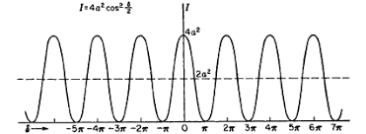
Intensity distribution curve:
Intensity at any point of the screen is expressed as
I = a₁² + a₂²+2a₁a₂ cosØ
If a₁=a₂, then I= 4a² for bright fringe and for dark fringe I=0. In fact as Øincrease gradually from 0 to ᴫ cosØ gradually decreases from +1 to-1 through 0 and intensity decreases gradually from 4a² to 0 . The shape of the intensity distribution curve is as shown in the figure below.
Figure: Intensity distribution of curve

Slide 3
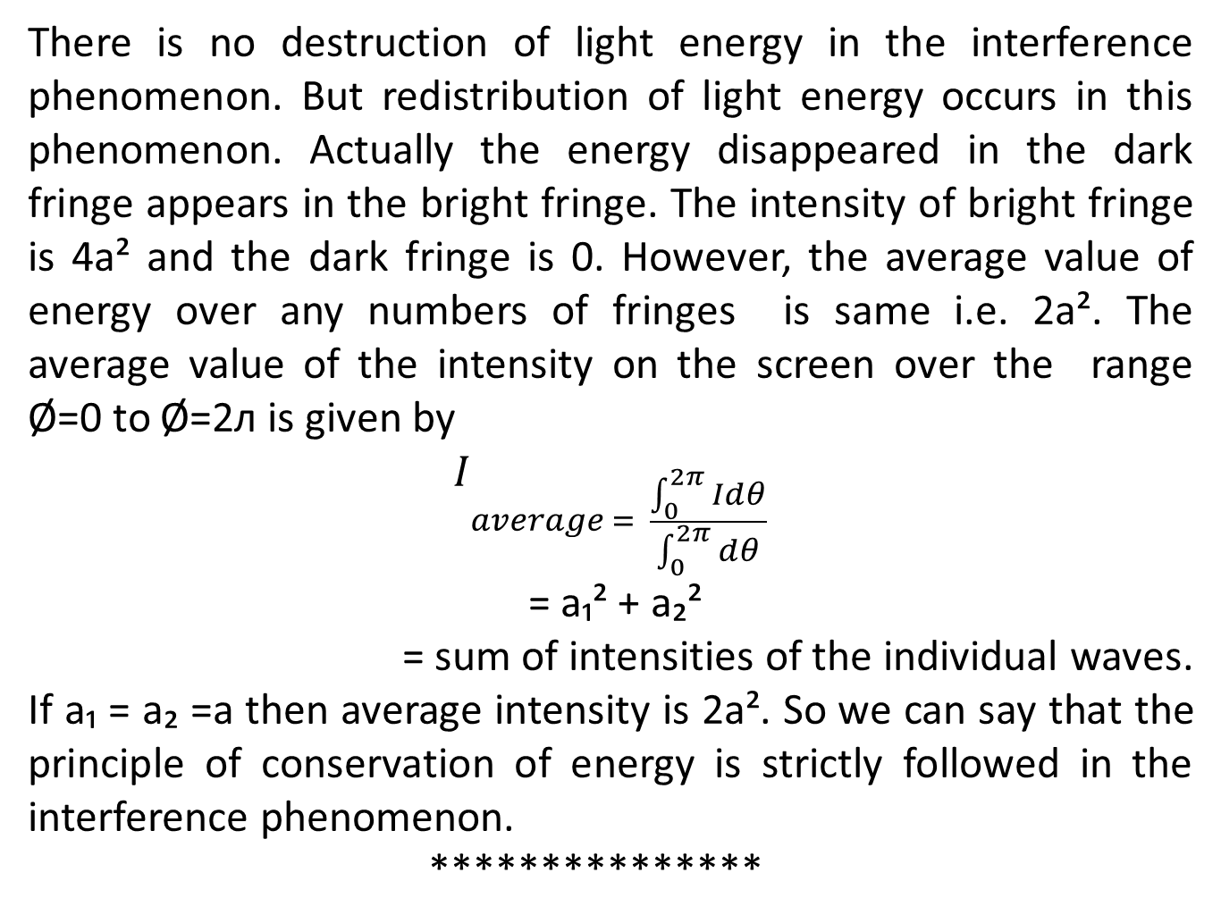

Slide 4
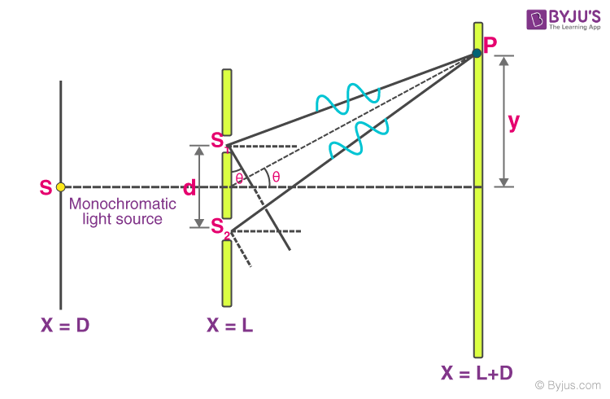
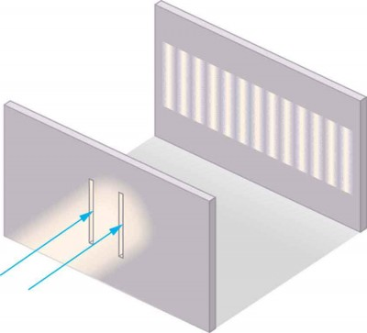
Young’s double slit experiment:
Let us consider two coherent sources S₁ and S₂ separated by a distance d sending monochromatic waves of wavelengthλ. C is central point on the screen and it is equidistant from S₁ and S₂. The perpendicular distance from the source to the screen is D. Let mth bright fringe be formed at point P which is at a distance y from the central point.

Slide 5
Now from figure we have
S₂P²= D²+( y + d/2)²
S₂P= D[1+ ( $\frac{y + d/2}{D})²$]½
= D[1+$\frac{1}{2}$($\frac{y + d/2)²}{D})$]
S₁P²= D²+( y - d/2)²
S₁P = D[1+ (${\frac{(y - d/2)}{D})}^{2}$]½
= D[1+$\frac{1}{2}(\frac{y - d/2)²}{D})]$
S₂P-S₁P (path difference)= $\frac{1}{2}$ $\frac{(y + d/2)²}{D}$ -$\frac{1}{2}\frac{{(y - d/2)}^{2}}{D}$
path difference x =$\frac{1}{2}\frac{2yd}{D}= \frac{yd}{D}$
Since D>>d, higher powers are neglected

Slide 6
For mth order bright fringe Y=Ym
S₂P - S₁P = mλ
Ym.d/D =mλ
Ym=mλD/d ……………….(1)
Similarly for( m+1) th order bright fringe
Y(m+1) =(m+1)λD/d ……………(2)
Thus the distance between two consecutive bright fringe is
β= Y(m+1) - Ym= λD/d …………………(3)
Similarly we can show that for dark fringe also
β= Y(m+1) - Ym= λD/d ………………………(4)
So fringe width β for dark and bright fringes are equal

Slide 7
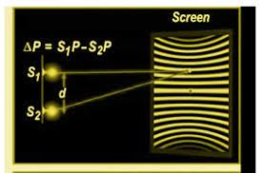
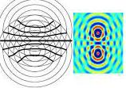
β is called as fringe width between two consecutive bright or dark fringes. Measuring β,D and d , λ can be measured.
Shape of interference fringes: If the two sources are pinholes instead of slits then the interference pattern would be hyperbolic as shown in the figure below.

Slide 8
If the screen is placed perpendicular to the line joining the two sources we get a number of alternately bright and dark concentric circles. These are non localized fringes because they can be obtained on a screen wherever it is placed. If path difference x ̴ 10⁻⁸ cm and slits separation d ̴ 10⁻² cm then the fringes are straight lines.
Interference with white light:
In white light there are different wavelengths for different colours. For the central fringe the path difference as well as phase difference is equal to zero for all colours. So we get a white fringe there at the central point.

Slide 9
We know that Ym=mλD/d which shows that when m > 0, Ym increases for greater values of λ. Since wavelength for red colour is greater than the wavelength of violet so value of Ym for red is greater the Ym value for violet. As a result of this we get a few coloured band in place of the bright fringe on either side of the central fringe and beyond it there we get general illumination.
************

