Slide 1
Plant Cell & Tissue Culture
Dr. Habibur Rahman
Associate Professor
J. N. College, Boko

Slide 9
Basic tools and techniques and various sterilization methods:
Various tools and techniques used are:-
1) ph meter
2) Autoclave -works on the principle of pressure cooker
3) Plant growth chamber.
4) Laminer Air Flow- works on the principle of HEPA.
5) Microscopy.
6) Colorimeter.
7) Centrifugation.
8). Chromatograply
1. Paper
2. Thinlayer
3. Two dimensional
9) Thermometer
10) Hygrometer

Slide 10
Methods of sterilization:-
1. Laboratory - cleanliness:-
1) Minimize the air current in the working area as much as possible.
2) Separate area for cleaning.
3) Laboratory, three types of sterilization is used
a dry heat
b) Wet heat
c) Filter sterilization
2. Sterilization of tools: Disinfectants are used for the sterlization of tools. Some of them are:-
(i) Ag (ii) Chlorine

Slide 11
3. Explants – Sterilization:
A suitable sized explant can be sterilized by any one of the following:-
1) 1-4% saturated solution of calcium hypochlorite.
2) 1% solution of bromine water
3) 70% ethyl alcohol
4) 0.1 - 0.2% mercuric chloride
5) 7% of sodium hypochlorite
6) 10% hydrogen peroxide solution
7) 1% silver nitrate solution

Slide 12
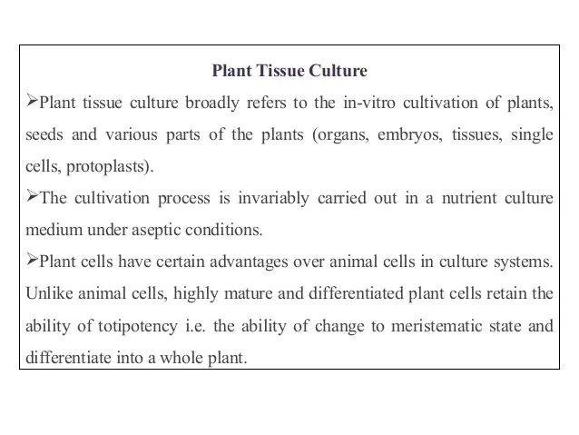

Slide 13
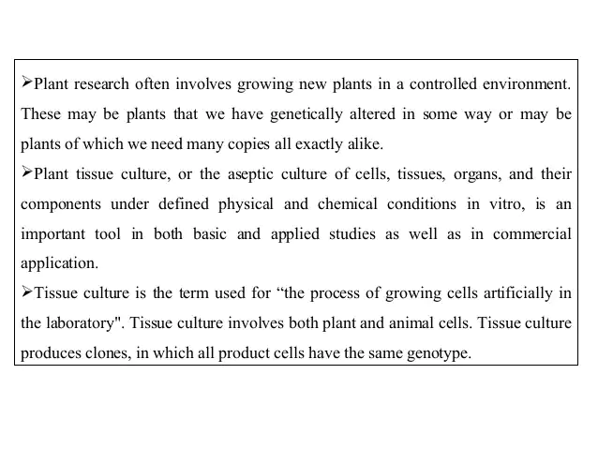

Slide 14
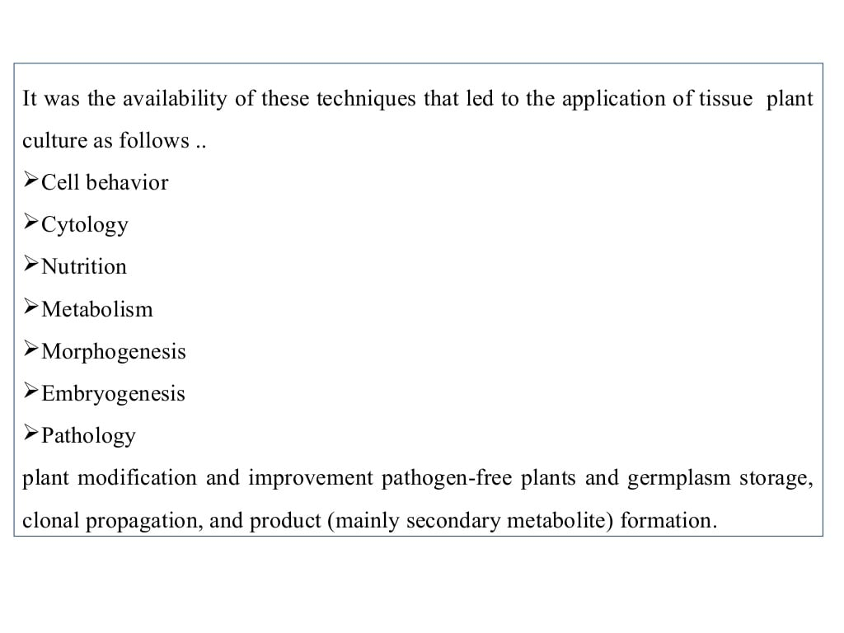

Slide 16
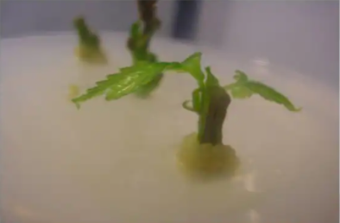

Slide 18
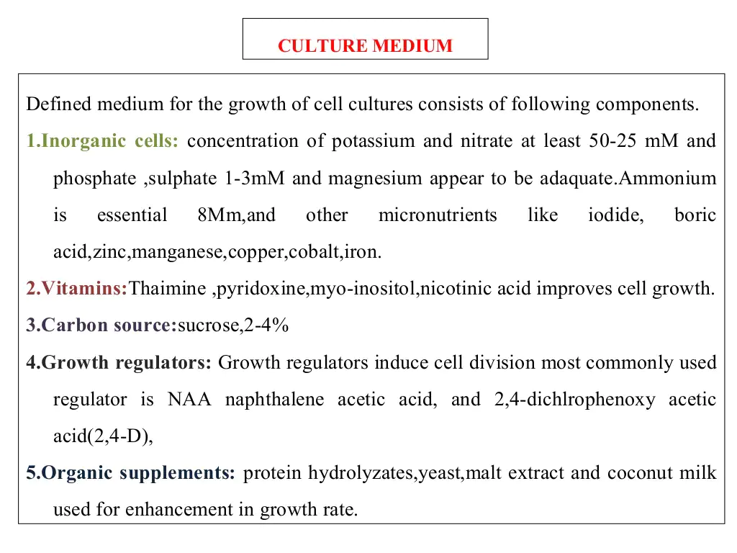

Slide 19
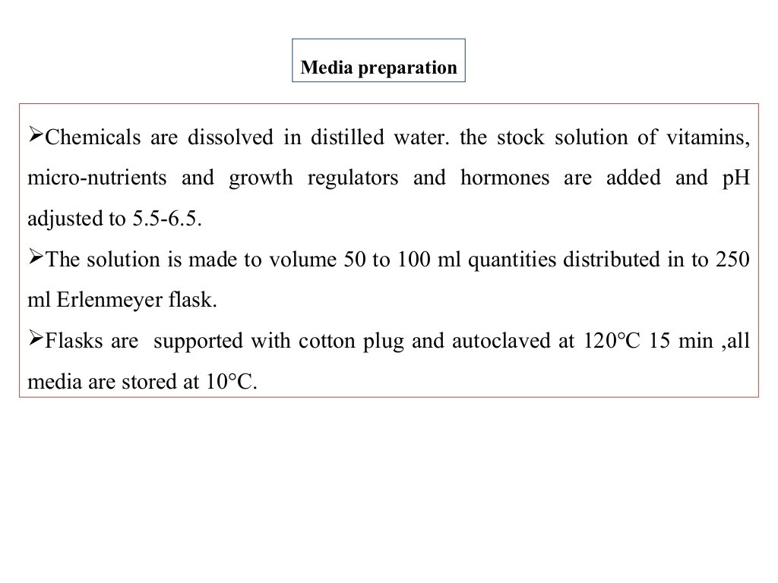

Slide 23
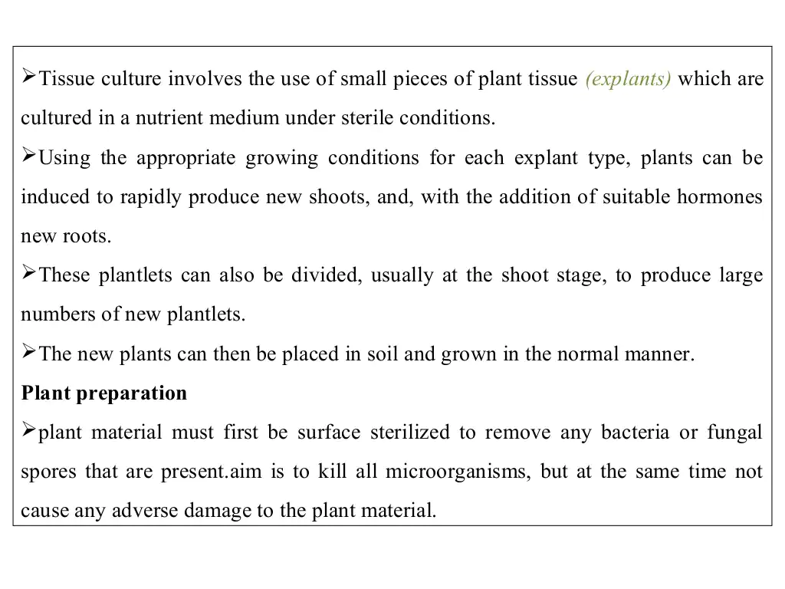

Slide 24
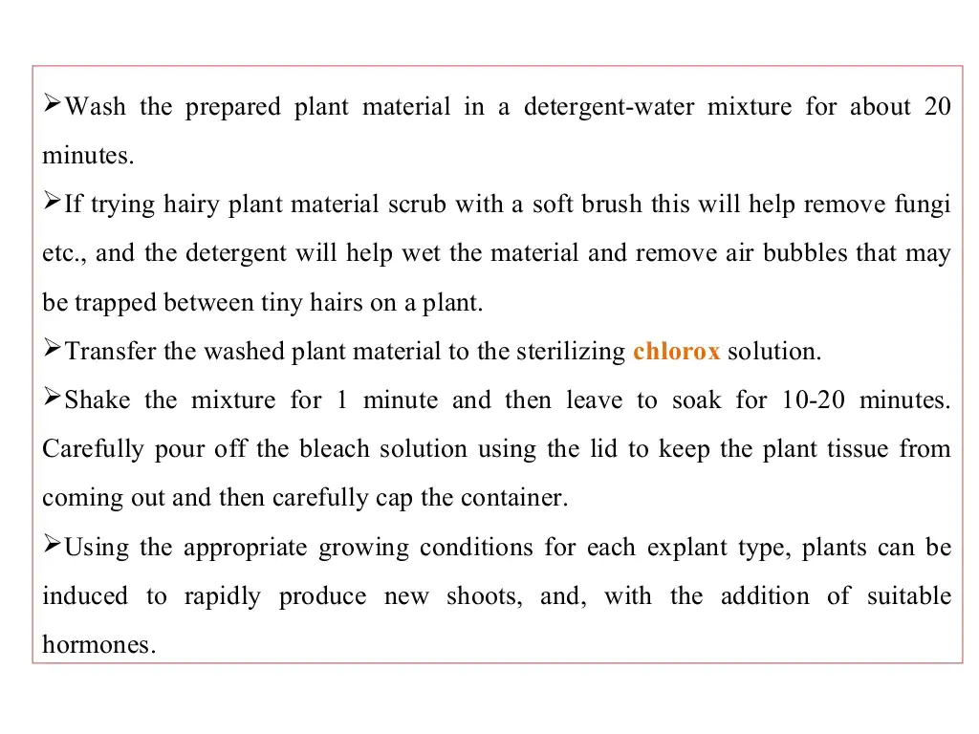

Slide 26
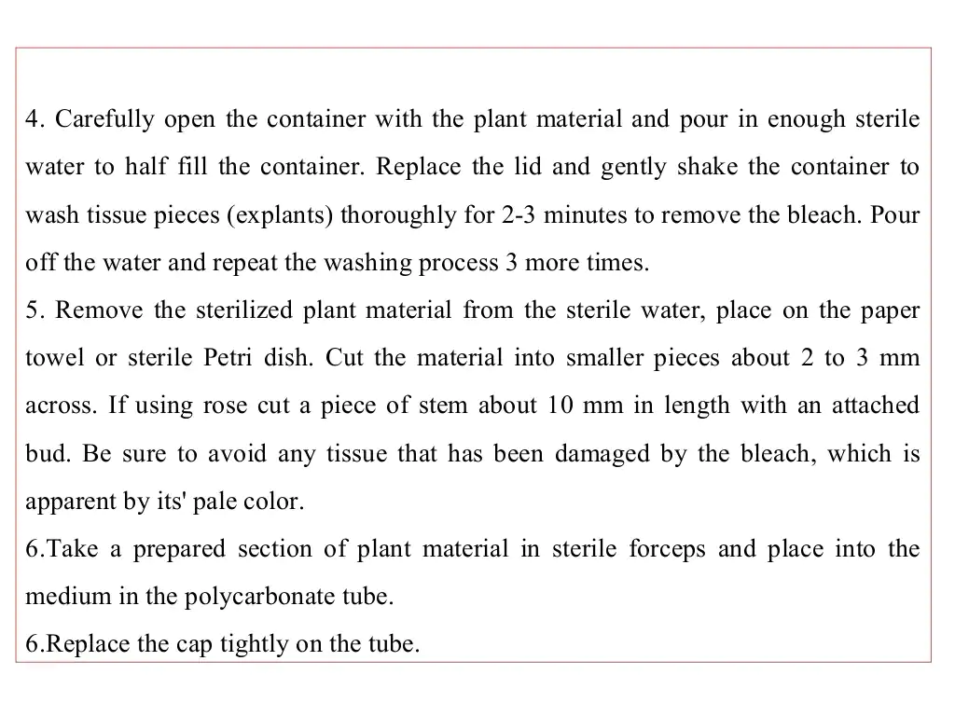

Slide 27
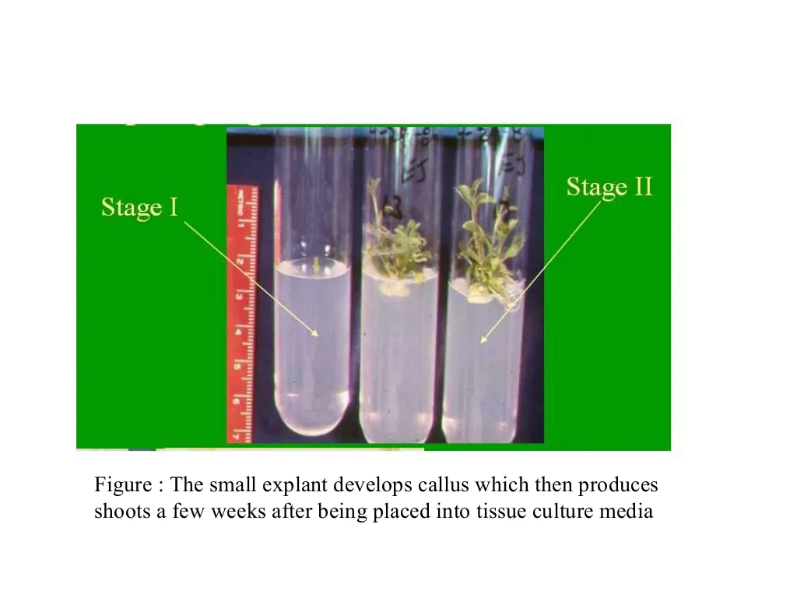

Slide 29
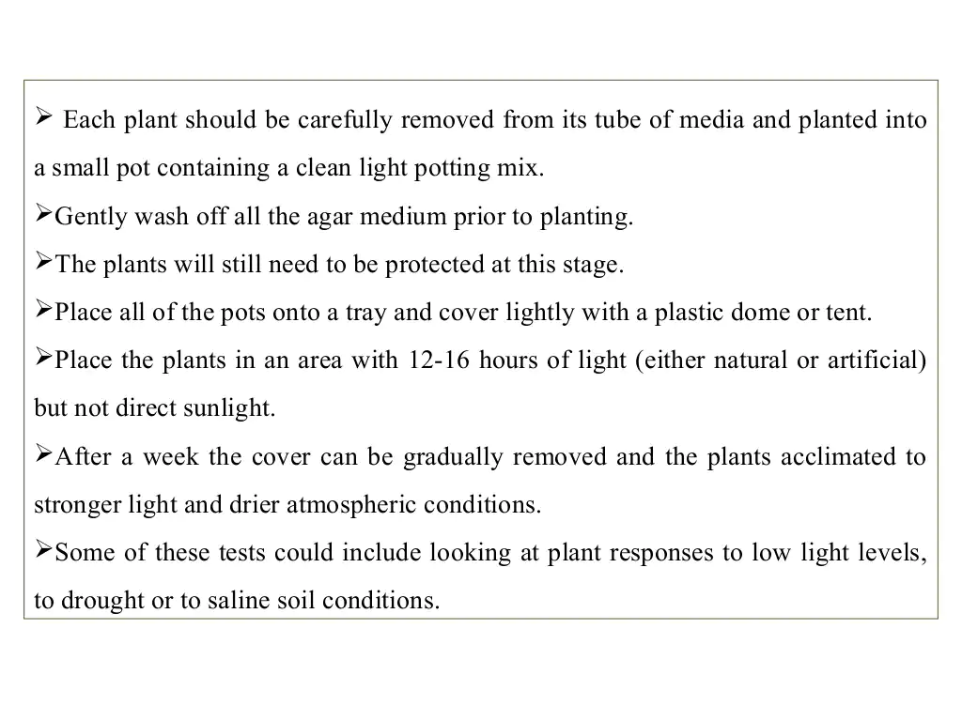

Slide 31
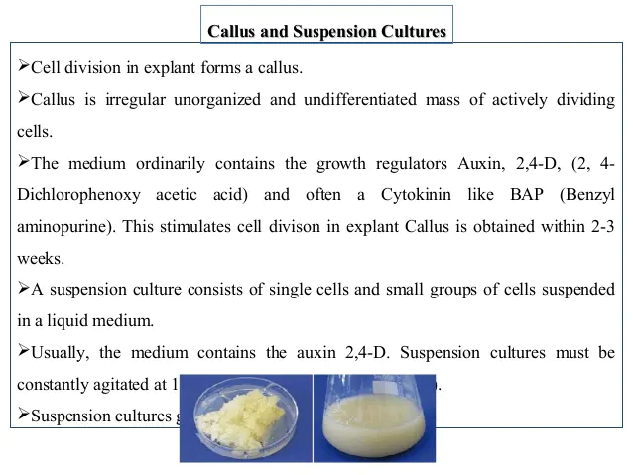

Slide 32
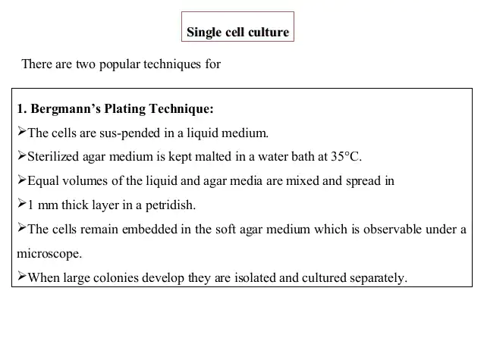

Slide 35
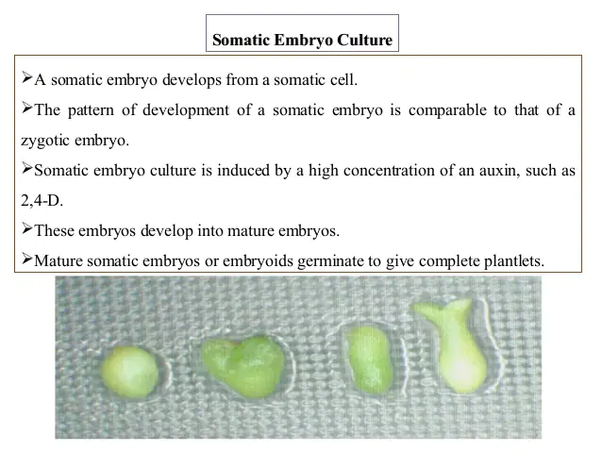

Slide 36
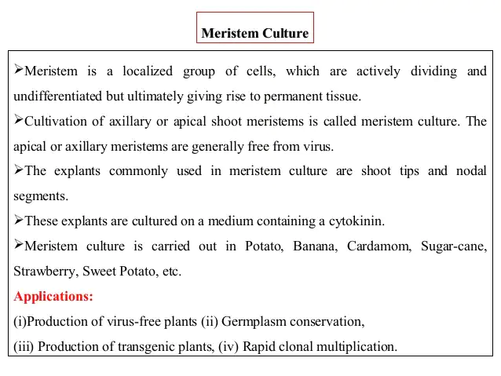

Slide 37
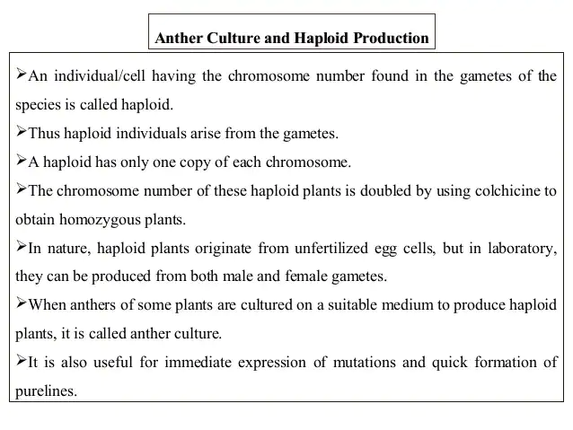

Slide 38
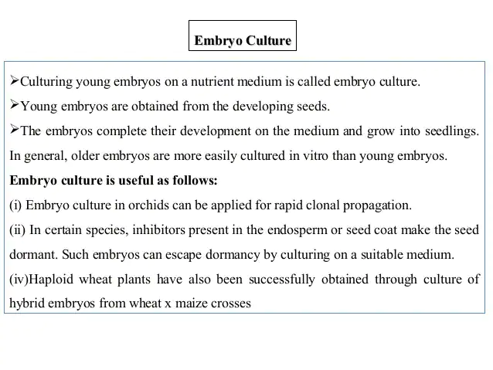

Slide 39
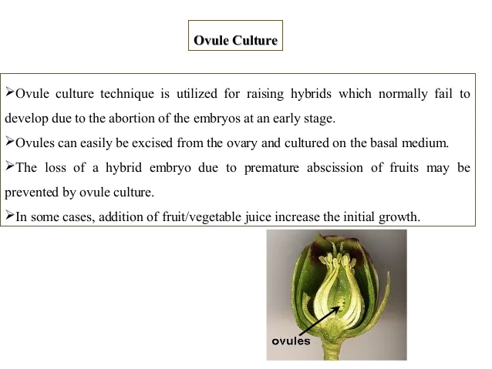

Slide 40
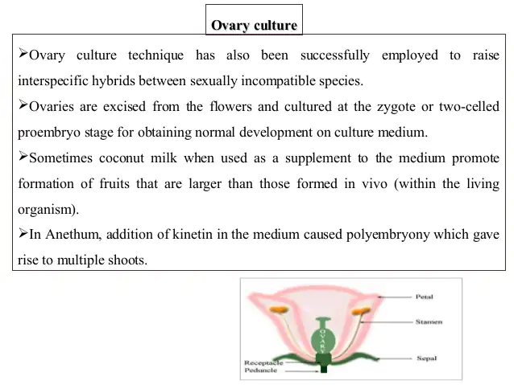

Slide 42
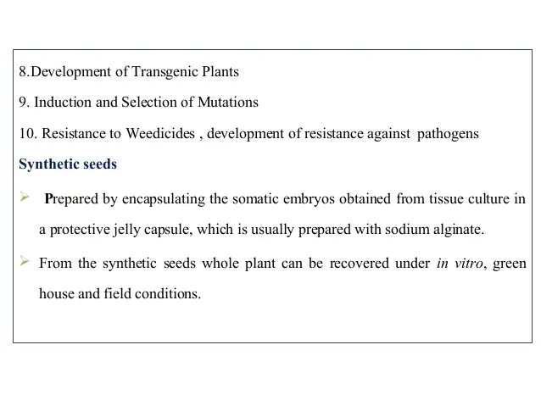

Slide 43
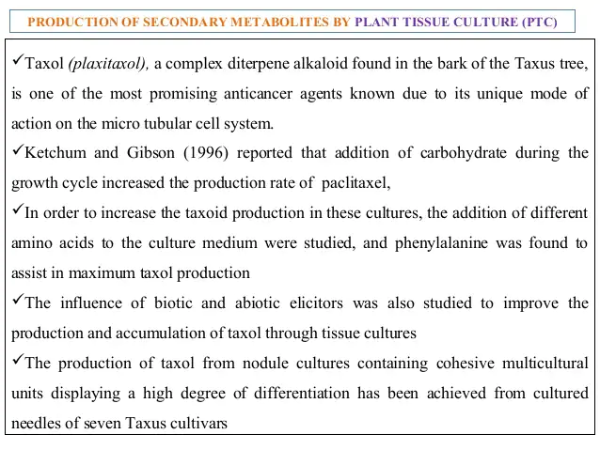

Slide 44
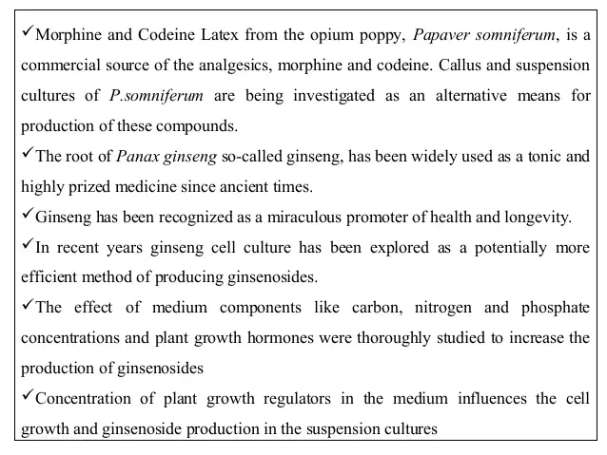

Slide 45
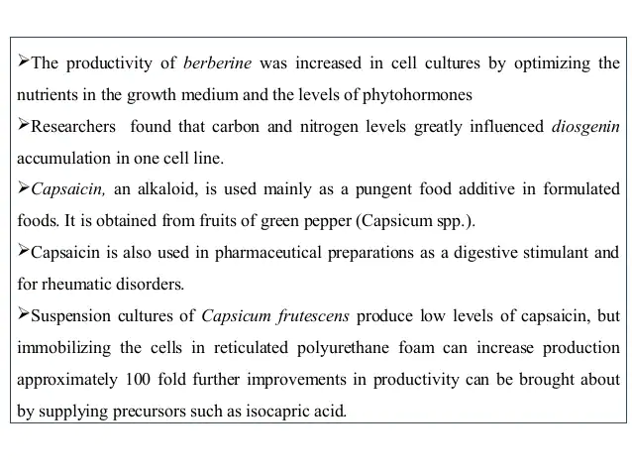

Slide 46
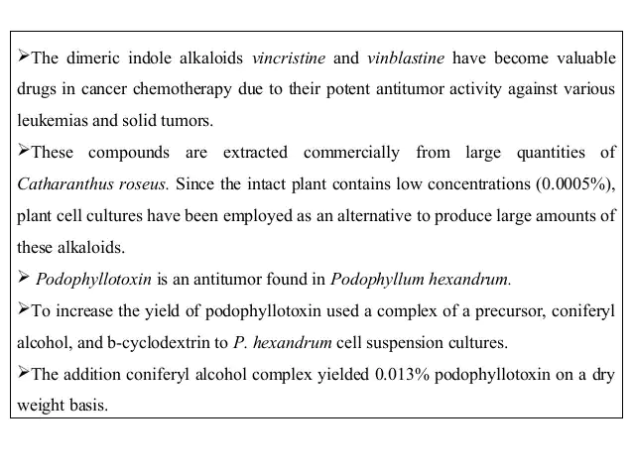

Slide 47
Transgenic plants are plants into which one or more genes from another species have been introduced into the genome, using genetic engineering processes.

