Slide 1
Micro propagation
Dr. Habibur Rahman
Associate Professor
J. N. College, Boko

Slide 2
Introduction:-
The technique of culturing plant became a wide subject embracing morphology, physiology, biochemistry, molecular biology and genetic engineering multiplication of plant through plant tissue culture can be achieved by any of the following methods depending on the objectives. The basic concept is to achieve rapid multiple without creating un wanted somaclonal variation.
Micro propagation is defined as production of miniature planting material in large number by vegetative multiplication through regeneration.
Axillary budding- It is the development from pre-existing meristems on nodal regions to ensure genetic stability of the regenerants.
Adventitious budding- De novo formation of adventitious buds (not from preexisting meristems) may occur directly from the tissues of the explant.

Slide 11
Types of Micropropagation Techniques:
Micropropagation techniques are of three types based on the way of propagation: first, the propagation from shoots with cytokinin like benzyladenine or kinetin; second, multiple shoot differentiation from dedifferentiating tissue, callus, with an auxin-like indole acetic acid; and finally, the embryo differentiation from callus.
The former two methods need the rooting process with an auxin-like indole acetic acid and with naphthalene acetic acid thereafter.
Nowadays, the method of propagation from shoots is the most preferred one, because the latter two methods present the possibility of genetic variation owing to the dedifferentiated phase, callus.

Slide 13
The technique of micro propagation is divided into four stages:-
Stage I:
Selection and establishment of Aseptic cultures.
i. In this, selection of typical, healthy, disease free mother plants.
ii. Selection of plant is followed by preparation of explants, surface sterilization and transfer to appropriate media.
iii. Sterilization is carried out through soaking in a calcium hypo chlorite. iv. Main aim is to attain an aseptic culture of the plant.
Stage- II:
Multiplication of Propagate
In this rapid multiplication of the regenerative system for obtaining large number of shoots.
ii. For this medium and tissue factors are optimized empirically.

Slide 14
Stage – III:
Plantlet Regeneration
i. Plantlets are produced through rooting of isolated shoots or germination of somatic embryos.
ii. Shoots of appropriate length or age are required, which depends on the medium Composition.
iii. High auxin concentration composition is used for the shoot development.
iv. Low salt strength of rooting medium facilitates the rooting.
v. In- vitro produced shoots are treated with auxins and transferred directly to pot mixture.

Slide 15
Stage – IV:
Preparation and transfer to field
i. It is concerned with transfer of plantlets in pots their hardening and establishment in soil.
ii. This stage is to prepare the propagule for these successful transfer to soil.
iii. Hardening of plants imparts some tolerance to moisture stress and plants become autotrophic from heterotrophic condition.
iv. Stage organs are formed on plantlets their establishment in soil becomes easier.
v. These tuberous organs may require chilling treatment to germinate.
vi. When plantlets are taken out from the vessels adhering with running tap water and plantlets are transferred in a soil.

Slide 16
vii. Plantlets are exposed to decreasing humidity by slowly exposing the plant or reducing the mist period in the glass house.
viii. Hardened plants are then transferred to glass or poly houses with normal environmental conditions.
ix. Plants are irrigitated frequently and their growth and variation are monitored regularly

Slide 17
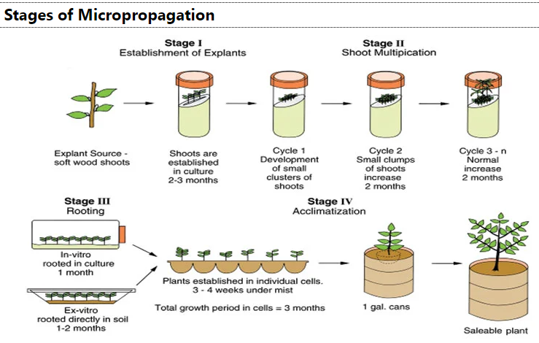

Slide 18
Advantages of Micro-Propagation:-
1) Shoot multiplication can be achieved in small space so became miniature plantlets can be produced.
2) Propagation is carried out under sterile condition. No damage is caused due to insects and diseases and plantlets are produced.
3) Virus free material is used (even through virus elimination by meristem culture) a large number of virus free plants can be obtained.
4) Plant tissue culture is carried out under defined conditions of environmental, nutritional and tissue system, therefore, it is a highly reproducible system under the defined set of conditions(controlled conditions, reproducibility).
5) This production is unaffected by seasonal variations as uniform conditions are maintained (no seasonal effect).

Slide 19
6) No care is required between two subculture as compared to conventional vegetative propagation system like watering, weeding (less care).
7) Small glass house space is required because of miniature size of plant lets
8) Mother plant or genotype of stock plant can be stood and maintained in vitro without damage to environmental factor and stock plants.
9) Being sterile transport across countries is permissible without difficulties
(transport across countries does not require phytosanitory regulation).
Miniature storage organs(tubers, corns, tuberous, roots) can be produced for genotype storage and subsequent plantation which is also called as Germplasm storage.
11) It is possible to mechanize whole process of vegetative propogation for large scale plantations.
12) The plants which are difficult to propagate vegetatively by conventional method can be propagated by this method.

Slide 20
Disadvantages of micro-propagation:-
1) Micro propagation method involve expensive material like autoclave, laminar air flow, controlled culture room.
2) It is a skilled work so a decision making and technique knowledge are required in the personnel.
3) Contamination cause severe damage to material and add to the cost of production, affects time schedule delivery of the material.
4) Genetic stability is not confirmed in certain methods.
5) Explants taken are delicate so it takes longer.
6) Specific conditions for micro-propogation may be required. Therefore, each material requires separate research method.

Slide 21
Limitation of Micropropagation:
Micropropagation techniques require intensive labor and this often limits their commercial application. Automation can reduce the labor required.

