Slide 1
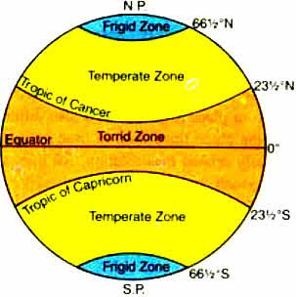
Heat zone
Heat zones of the earth surface are
Broadly categorized into following
Zones:
Torrid zone
Temperate zone
Frigid zone

Slide 2
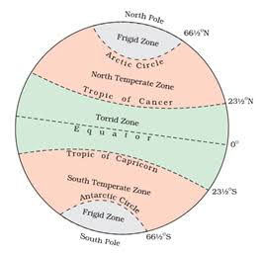

Slide 3
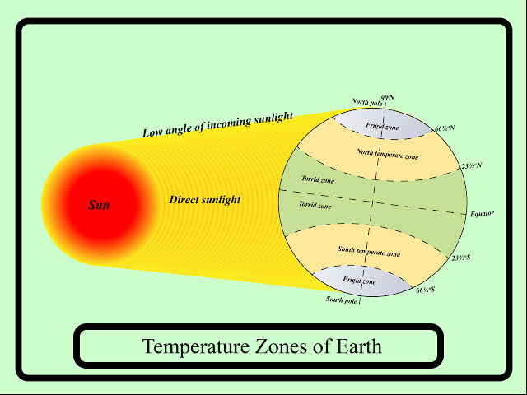

Slide 4
Torrid Zone
The Torrid Zone is located between the Tropic of Cancer at 231/2° N and the Tropic of Capricorn at 231/2° S, covers 39.78% of Earth's surface.
This zone is bounded on the north by the Tropic of Cancer and on the south by the Tropic of Capricorn; these latitudes mark the northern and southern extremes in which the sun passes directly overhead
Temperate Zone
The North Temperate Zone, between the Arctic Circle at 661/2° N and the Tropic of Cancer at 231/2° N, covers 25.99% of Earth's surface.
The South Temperate Zone, between the Tropic of Capricorn at 231/2° S and the Antarctic Circle at 661/2° S, covers 25.99% of Earth's surface.
In the two temperate zones, consisting of the tepid latitudes, the Sun is never directly overhead, and the climate is mild, generally ranging from warm to cool.

Slide 5
Frigid Zone
The North Frigid Zone, between the North Pole at 90° N and the Arctic Circle at 661/2° N, covers 4.12% of Earth's surface.
The South Frigid Zone, from the Antarctic Circle at 661/2° S and the South Pole at 90° S, covers 4.12% of Earth's surface.
In the center of the zone (the pole) the day is one year long with six months of daylight and six months of night. The frigid zones are the coldest regions of Earth and are generally covered in ice and snow. It receives slanting rays of the sun as this region lies farthest from the equator

Slide 6
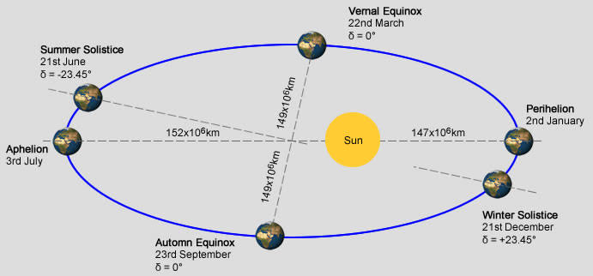
Perihilion, Aphelion, Solastice and Equinox
3rd January
4th July

Slide 7
Aphelion is the point of the Earth’s orbit that is farthest away from the Sun. Each year on July 4th the earth little furthe from the sun at distance 152 million km.
Perihelion is the point of the Earth’s orbit that is nearest to the Sun. Each year on January 3rd the earth come close to the sun at distance 147 million km.
The day of a solstice in either hemisphere has either the most sunlight of the year (summer solstice) or the least sunlight of the year (winter solstice) for any place other than the Equator.

