Slide 1
Remote Sensing
Presented By
Dr. Banashree Saikia
Assistant Professor
Department of Geography
JN College,
Boko

Slide 2
Basics of Remote Sensing
Remote Sensing may be defined as the “science and art of acquiring information about an objects made from a distance without physical contact with the object”. In other words, Remote Sensing means, observing an object or phenomena from a distant place
The information may be acquired from aircraft or artificial satellite.
The principle of remote sensing is same with that of human eye vision, where the reflected sun rays are sensed by the eye sensor and send the information to brain for identification of the feature.
The basic principle of Remote sensing is explained as when the insolation absorbed by the objects on the earth surface and is reflected back in the atmosphere ,then the remotedly placed sensors picked up the reflected energy which are in the form of Electro Magnetic Radiation(EMR).

Slide 3
These reflected energy are recorded by a device in the digital form.Finally, the digital form transformed into pictoral form by the users. This is the basic mechanism of Remote Sensing.
In case of artificial remote sensing, a sensor is fitted in the satellite which records the amount of reflection reflected by various earth’s features in different wave length region (known as bands) so as to identify and distinguish the objects from each other

Slide 4
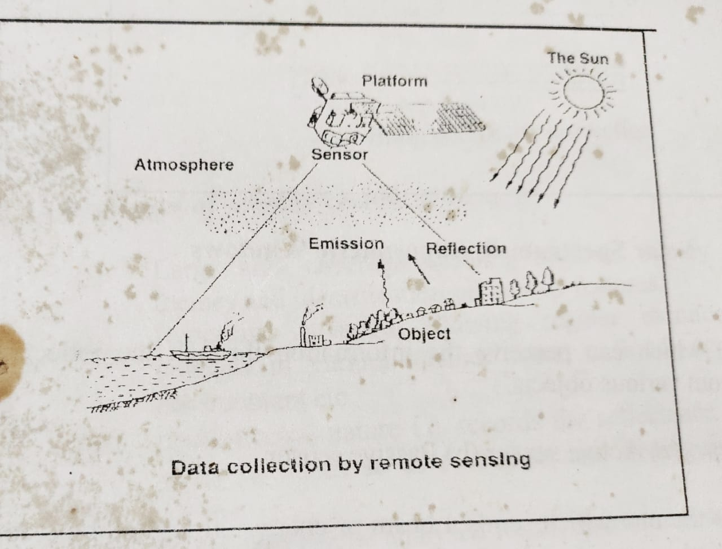

Slide 5
The solar spectrum consists of various electromagnetic radiation viz. Gamma rays,X rays, UV rays, visible rays, infra red rays, thermal rays, microwave, radio etc
But all these rays can not reach earth’s surface and maximum are attenuated by the atmosphere.
Only few of them can pass through the atmosphere to reach the earth surface which are called Atmospheric windows. These are visible rays, infra red, thermal and micro wave. Satellite sensors are capable of sensing the reflections of these EMR.

Slide 6
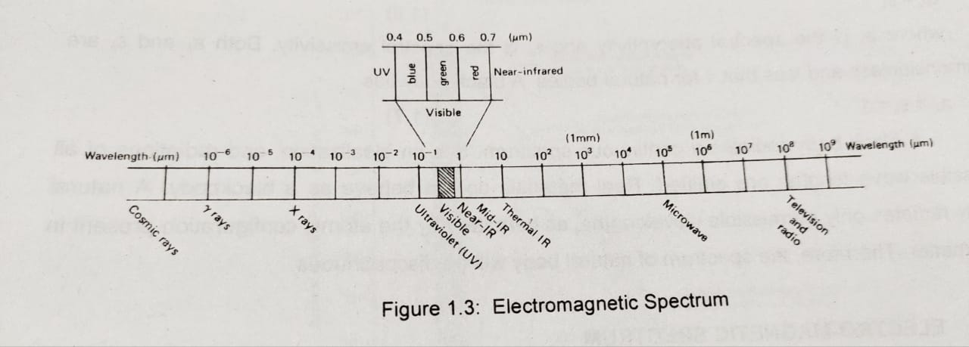
Electromagnetic spectrum is the ordering of EMR s according wavelength, or in other words , frequency or energy. The most prevelant unit used to measure wavelength along the spectrum is the micrometer (µm). A micrometer equals to 1*10⁻⁶.

Slide 7
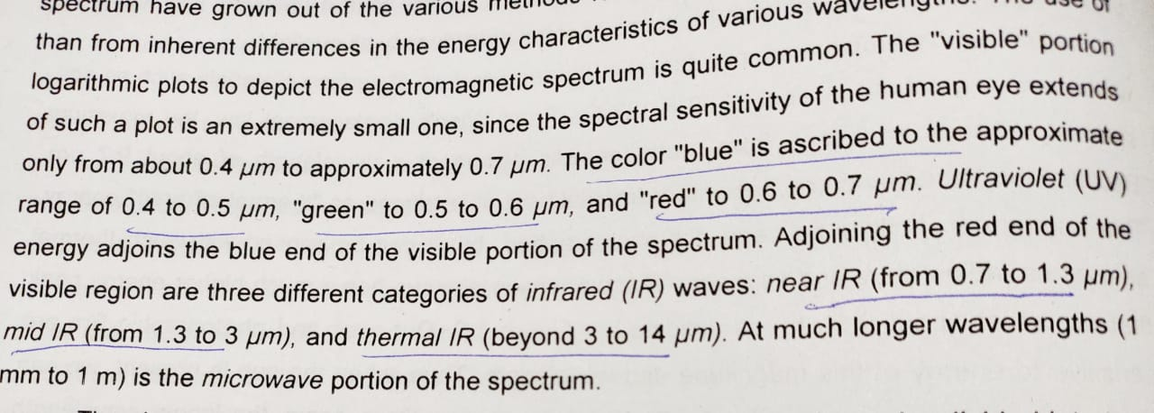

Slide 8
Components of Remote Sensing
Source of Electromagnetic energy (Sun).
Medium which interacts with these energy i.e, atmosphere
Growth objects
Sensor to detect and record the changes in electromagnetic energy.

Slide 9
Sensor
It is a device which can perceive the information through the reflected / emitted light from various objects.
Types of Sensors: (a) Active sensor (b) Passive sensor
Active sensor is the one which sends a beam of energy on to the object and detects the reflected energy.Ex. RADAR.
Passive sensor is the the one which uses the sun as the source of energy and detects the reflected energy

Slide 10
Platforms of Remote Sensing
Remote Sensing images are obtained at distances from various plateforms.On the basis of these platforms, the techniques and types of remote sensing also very. Remote sensing images are obtained at distances that fall within the following broad ranges:
Sensor carried by balloons which are designed and used for specific projects.
Sensors carried by aircraft, these sensors generally obtain images at height of 500 mt. to 20 km. Aircrafts are useful for good regional cover ages with high resolution.
Sensors carried by spacecraft, which generally operate an altitudes of around 250- 300 km. Many remote sensing satellites operate approximately thousand k.m above the earth.
Very high altitude satellites operate 36000 km. above the earth. These are geostationary satellites which remain over the same part of the earth at all times.

Slide 11
Types of Remote Sensing
There are three types of Remote Sensing:
Ground remote sensing: Where sensor is placed in a handheld Radiometer to measure the amount of reflections.
Aerial remote sensing: Where sensor/ camera is placed on aircraft
Satellite remote sensing: Where sensor is placed on artificial satellite.

