Slide 1
FREE ELECTRON THEORY SOLID STATE PHYSICS - V
Dr. Ranjit Baishya
J.N.College;Boko

Slide 2
Syllabus:
(b) SOLID STATE PHYSICS: Total Marks: 45 ( 60% of 45 = 27)
The idea of amorphous and crystalline solids, The crystal lattice and translation vectors, unit cell, types of crystal lattice, Miller indices, diffraction of X-rays, use of Bragg’s law to the determination of lattice constants. 10 Lectures
The different types of crystal bonding: ionic, covalent, metallic, Van der Waal and hydrogen bondings, cohesive energy of ionic crystal, Madelung constant. 5 Lectures
Free electron theory of metals, Boltzmann’s equation of state, electronic specific heat, electrical and thermal conductivity of metals, Wiedemann-Franz law.(Quantum Mecanical treatment to be used).Bloch theorem in one dimension, Kronig-Penny 20 model of energy bands of solids, distinction among metal, insulator and semiconductor, intrinsic and extrinsic semiconductors. 15 Lectures
------------------------------------------------------------------------------ 30 Marks -----------------
Introductory concept of superconductivity, Meissner effect, types I and type II superconductors. 5 Lectures
Magnetic properties of solids: Magnetization, magnetic intensity, magnetic susceptibility, permeability, hysteresis, B-H curve and energy loss in hysteresis, different classes of magnetic material, magnetic moment, Bohr magneton, Larmor precession, Classical theory of paramagnetism(Langevin’s theory and Curie law), Weiss theory(Quantum Mecanical treatment to be used), relation between para and ferromagnetism, Ferromagnetic domain. 10 Lectures

Slide 3
604. (b) COMPUTER APPLICATIONS: Total marks: 30
1. Programming exercise (FORTRAN-95 or C or C ++ ):
simple mathematical series generation and summation,
sorting of numbers largest of n numbers,
sorting a list ascending/descending order,
solution of quadratic equation,
solution of simultaneous linear equation,
-------------------------------------------------------------------- 18 Marks ------
least square graph fitting (straight line and
quadratic curve) of given data,
iterative methods,
implementation of Runge-Kutta 4th order
method of solving differential equation
Simpson's rule for integration.
30 Lectures

Slide 4
Free Electron Theory of Metals:

Slide 11
Electrical Conductivity:
Electrical conductivity is defined as the quantity of charge ‘q’ that flows in a unit time through a unit area of cross section of the conductor per unit potential gradient.
V = IR
=> E.L = (q /t)(L /σA)

Slide 12
T – Relaxation time
λ – mean free path

Slide 14
Thermal Conductivity:
Thermal conductivity is defined as the quantity of heat energy that flows in a unit time through a unit area of cross section of the material when opposite faces are maintain at a unit difference of temperature.

Slide 16
Wiedemann Franz Law:
All good conductors of electricity are also good conductors of heat. This fact is given in the form of Wiedemann Franz Law. The law states that “the ratio of thermal conductivity to electrical conductivity is proportional to the absolute temperature”. i.e.
Thermal Conductivity:
Electrical Conductivity:

Slide 17
Thus
- - is a constant
This is Wieldemann Franz Law.
This law is not true at very low temperature.

Slide 18
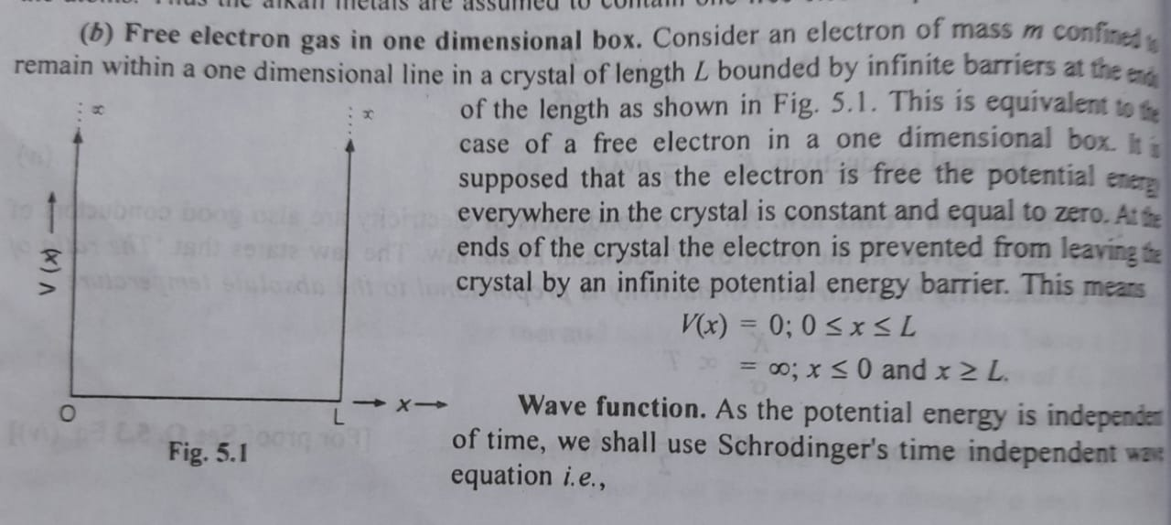

Slide 22
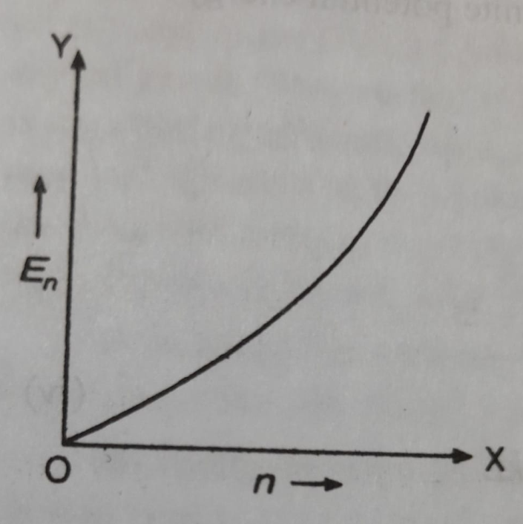
Eigen Values of Energy:

Slide 23
Fermi Level:
Let us suppose we want to accommodate N electrons on the line. According to Pauli’s Exclusion Principle, no two electrons can have all their quantum numbers identical. i.e. each quantum state can be occupied by at the most one electron. In a solid an electron in a conduction electronic state has quantum numbers ‘n’ (principal Q.N.) and ‘m_{s}‘ (magnetic spin Q. N.). Each set of values of ‘n’ and ‘m_{s}‘ defines a quantum state. For each value of n, m_{s} can have two possible values (+1/2) and (- ½). i.e. n can have two quantum states and hence can accommodate a maximum of two electrons, one with spin up ( ) and other with spin down ( ).

Slide 24
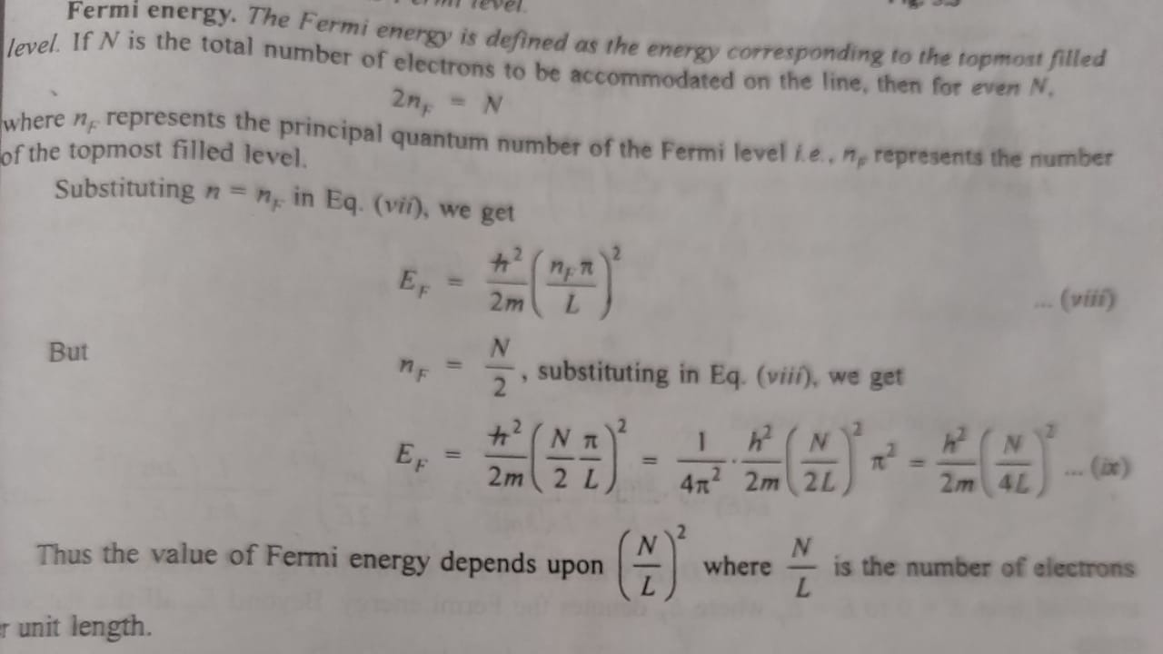

Slide 26
THANK YOU
ALL THE BEST

