Slide 1
Tissue Culture
Pinaki Kr. Rabha

Slide 2
The term tissue culture may be defined as the process of in-vitro culture of explants in nutrient medium under aseptic conditions. It includes the culture of cell, organ culture and suspension culture etc.
German botanist Gottlieb Haberlandt was regarded as father of tissue culture.
The basis of tissue culture is totipotency of cell.

Slide 3
German botanist Gottlieb Haberlandt first attempted to culture plant tissues ‘in vitro’. He started his work in 1898. He used cells from palisade tissues of leaves, cells from pith, epidermis and epidermal hairs of various plants for culture in media -containing Knop’s solution, asparagine, peptone and sucrose.

Slide 4
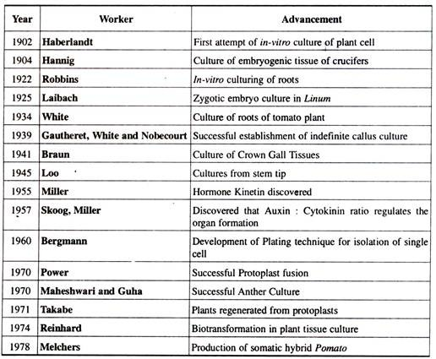

Slide 5
The main requirements of plant tissue culture are:
(1) Laboratory Organisation
(2) Culture Media
(3) Aseptic Conditions

Slide 6
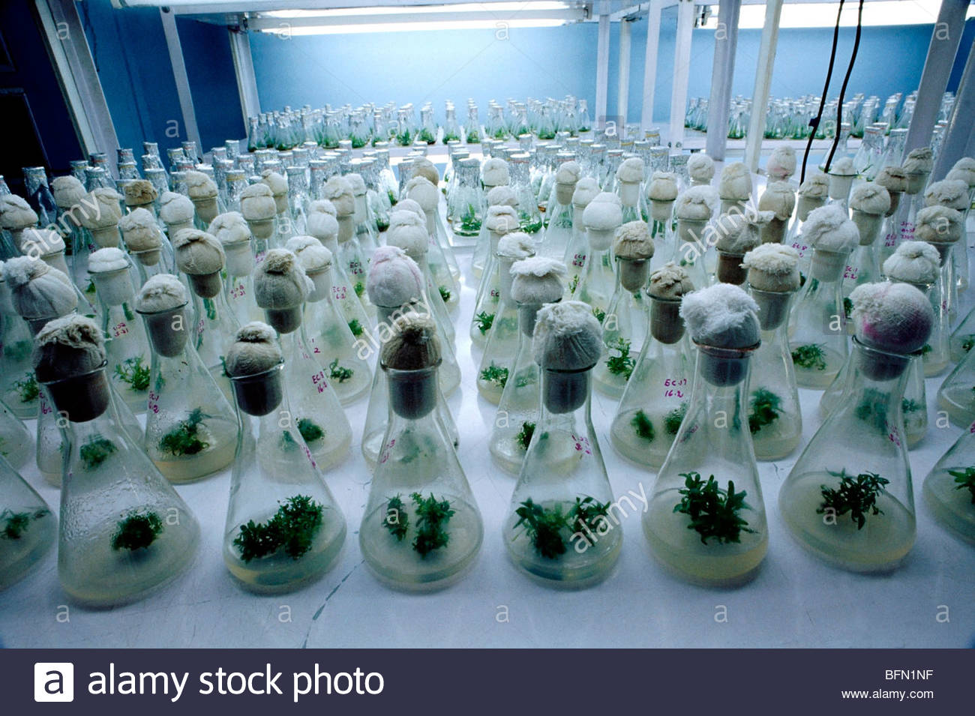
Laboratory Organisation:
i. A Media Room for preparation, sterilization and storage of culture media.
ii. Facilities for washing of lab-wares, explants, etc.
iii. Space for storage of lab-wares.
iv. Culture rooms or incubators where conditions of temperature, humidity and light etc. can be maintained.
v. Observation and Data Collection area.

Slide 7
Culture Media:
The formulation or the medium on which the explant is cultured is called culture medium. It is composed of various nutrients required for proper culturing. Different types of plants and organs need different compositions of culture media. A number of media have been devised for specific tissues and organs.
Some important of them are:
MS (Murashige and Skoog) Medium
LS (Linsmaier and Skoog) Medium
B5 (Gamborg’s) Medium
White’s Medium, etc.

Slide 8
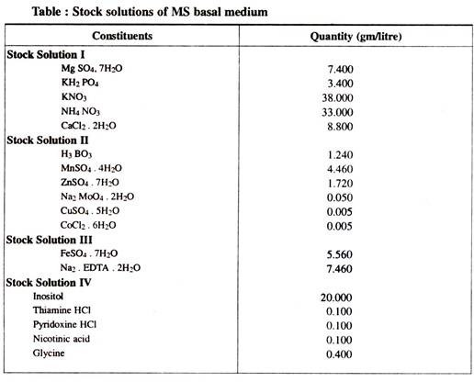

Slide 9
Important constituents of a culture medium are:
i) Organic supplements:
(a) Vitamins like thiamine (B₁), Pyridoxin (B₆), Nicotinic Acid (B₃), etc.
(b) Antibiotics like Streptomycin, Kanamycin;
(c) Amino Acids like Arginine, Asparagine.
(ii) Inorganic Nutrients:
Micronutrients as Iron (Fe), Manganese (Mn), Zinc (Zn), Molybdenum (Mo), Copper (Cu), Boron (B).
Macronutrients include six major elements as Nitrogen (N), Sulphur (S), Phosphorus (P), Potassium (K), Calcium (Ca), Magnesium (Mg).
(iii) Carbon and Energy Source:
Most preferred carbon source is Sucrose. Others include lactose, maltose, galactose, raffinose, cellobiose, etc.

Slide 10
(iv) Growth Hormones:
a. Auxins-mainly for inducing cell division.
b. Cytokinins-mainly for modifying apical dominance and shoot differentiation.
c. Abscisic Acid (ABA)-Used occasionally.
d. Gibberellins-Used occasionally.
Gelling Agents:
These are added to media to make them semisolid or solid. Agar, Gelatin, Alginate etc. are common solidifying or gelling agents.
Other Organic Extracts:
Sometimes culture media are supplemented with some organic extracts also like coconut milk, orange juice, tomato juice, potato extract, etc.

Slide 11
Aseptic Conditions:
Maintenance of aseptic conditions is the most critical and difficult aspect of in-vitro culturing experiments. The most common contaminants in culture are fungi and bacteria.
Measures to be taken for maintaining asepsis during tissue culture are:
i. Sterilization of the culture vessels using detergents, autoclaves, etc.
ii. Sterilization of instruments like forceps, needles etc. by flame sterilization.
iii. Sterilization of culture medium using filter sterilization or autoclaving methods.
iv. Surface sterilization of explants using surface disinfectants like Silver Nitrate (1%), H₂O₂ (10-12%), Bromine water (1-2%), Sodium Hypochlorite solution (0.3-0.6%), etc.

Slide 12
General Technique of Plant Tissue Culture:
General technique of plant cell, tissue and organ culture is almost the same with a little variation for different plant materials. There are certain basic steps for the regeneration of a complete plant from an explant cultured on the nutrient medium .

Slide 13
(a) Selection and Sterilization of Explant:
Suitable explant is selected and is then excised from the donor plant. Explant is then sterilized using disinfectants.
(b) Preparation and Sterilization of Culture Medium:
A suitable culture medium is prepared with special attention towards the objectives of culture and type of explant to be cultured. Prepared culture medium is transferred into sterilized vessels and then sterilized in autoclave.

Slide 14
(c) Inoculation:
Sterilized explant is inoculated (transferred) on the culture medium under aseptic conditions.
(d) Incubation:
Cultures are incubated in the growth chamber/ tissue culture room at 25±2°C, 50-60% relative humidity and 16 hours of photoperiod. After define period callus develops on the medium or shoots/ roots develops from explant.

Slide 15
(e) Sub culturing:
Cultured cells are transferred to a fresh nutrient medium to obtain the plantlets.
(f) Hardening:
Hardening is the gradual exposure of plantlets for acclimatization to environmental conditions.
(e) Transfer of Plantlets:
After the hardening process, the plantlets are transferred to green house or in pots.

Slide 16
Applications of Plant Tissue Culture
1. Germplasm conservation mainly in the form of cryopreservation of somatic embryos or shoot apices, etc.
2. Some plants produce secondary metabolic products, such as, alkaloid, anti­biotic, glycoside, resin, tannin, saponin, volatile oil, etc., which are of considerable economic importance.
By cell culture various secondary metabolites (e.g. allergin) have been synthesised artificially. Cultivation of plants producing secondary metabolites can be improved significantly by tissue culture.
3. Technique of micro propagation for enhancing the rate of multiplication of economically important plants.
4. Eradication of systemic diseases in plants and raising disease free plants.

Slide 17
5. Soma-clonal variations are useful sources of introduction of valuable genetic variations in plants.
8. Embryo culture helps in overcoming seed sterility and dormancy.
9. Haploid production in culture helps to solve various problems of genetic studies and thus aids the plant breeders for producing new varieties.
10. Seedless fruits and vegetables can be produced by following the endosperm culture method which add to their commercial values.

Slide 18
11. Plant tissue culture aids in producing the genetically transformed plants.
12. Early flowering can be induced by in-vitro culturing of plants so as to attain commercial benefits.
13. Triploids as well as polyploid plants can also be produced by tissue culture techniques for uses in plant breeding, horticulture and forestry.
14. Different tissue culture techniques help us to study various biosynthetic processes, physiological changes and cytogenetic changes.

