Slide 1
DIASPORA IN INDIAN WRITING IN ENGLISH
Phanindra Prasad
Jengraimukh Majuli, Assam

Slide 2
Introduction
The word “diaspora,” was originally coined from Greek term, ‘diaspora’ which means dispersion or scattering.
Historically, the concept of diaspora refers to the dispersion of the Jews from Babylon in the 6th Century BC,
And later was used to refer to all migrants who left their homeland to go to another country for various reasons.
Diaspora literature revolves around the idea of a homeland or a place from where the displacement happens.
it deals with the narration of harsh journeys taken on by the characters due to their expulsion

Slide 3
Diaspora Types
Diasporas may emerge rge for a variety of reasons, including political persecution of people within their homelands, economic opportunity, or natural disasters.
The African Diaspora is the voluntary and involuntary movement of Africans and their descendants to various parts of the world during the modern and pre-modern periods.
Italian Diaspora: Moved to US cities like New York and Chicago.
Jewish Diaspora: Spread to all corners of the world, with the largest concentrations in Israel and the United States
Cuban Diaspora: Largest concentrations are found in Florida, Venezuela, and Spain

Slide 4
Reason
The Africans were transported to different countries to serve as slaves, free labor to build the companies and plantations for wealthy slave owners. The men, women, and children were examined at public auctions and sold to the highest bidder.
Between 1845 and 1917, more than 150,000 indentured laborers from India were brought to Trinidad and Tobago to work on sugar, cocoa, and coconut plantations.
During the administration of the French East India Company rule at least 12,000 Indian workers went to Mauritius between 1721 and 1810 before the abolition of slavery.

Slide 5
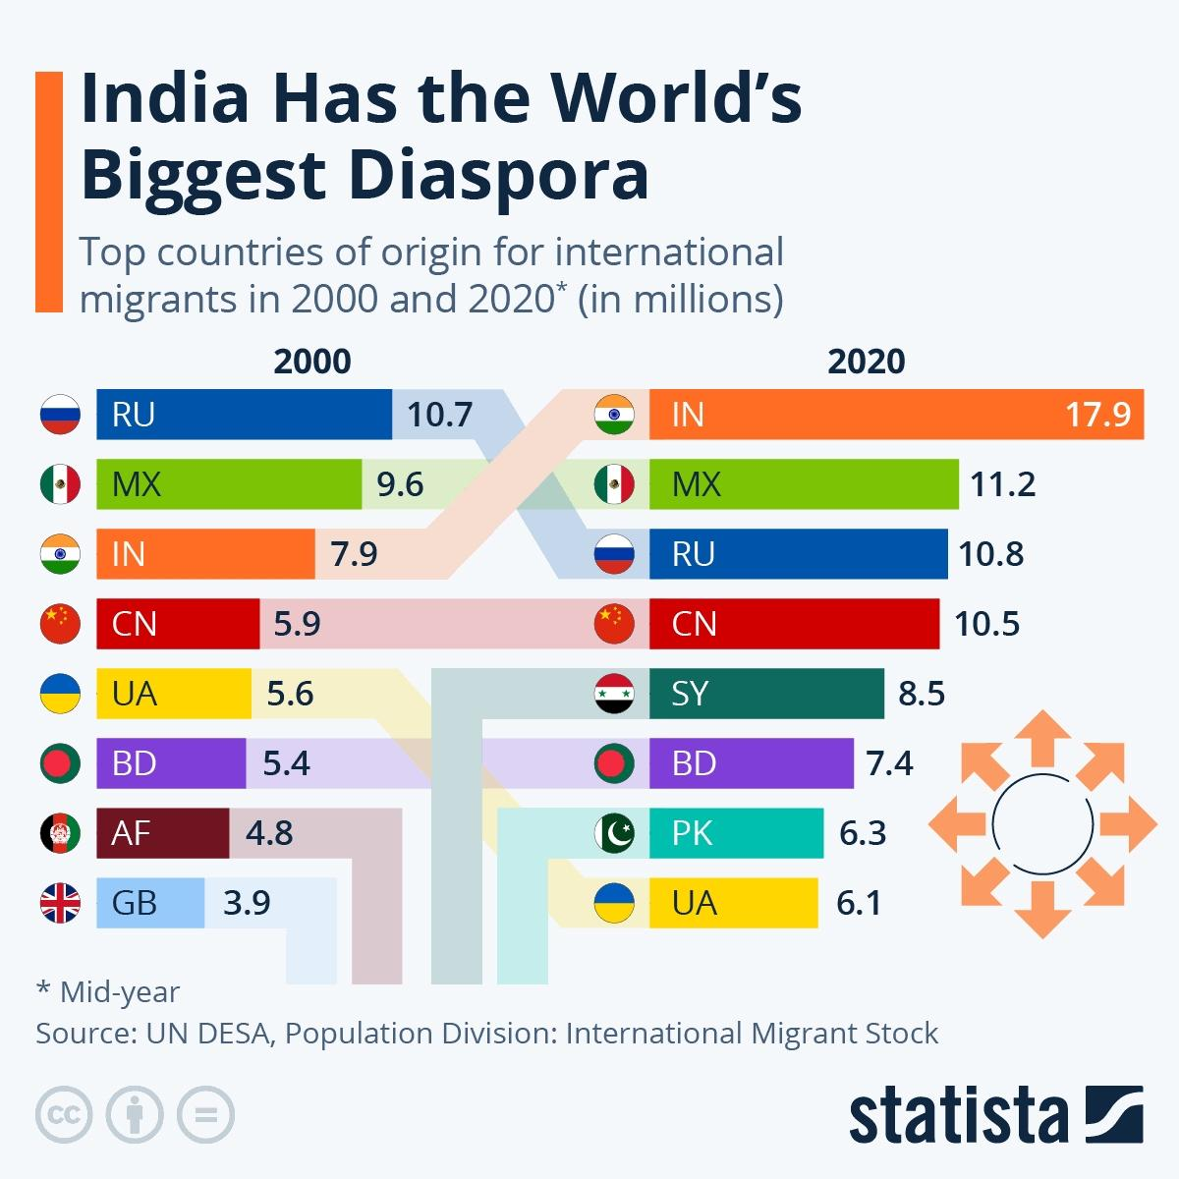
Indian Diaspora
India had the most people living abroad of any country worldwide in 2020, according to the UN’s latest data published in the World Migration Report 2022.
This chart shows how India overtook Mexico and Russia between 2000 and 2020, with an incredible 10 million more Indians now living abroad than 20 years ago.

Slide 6
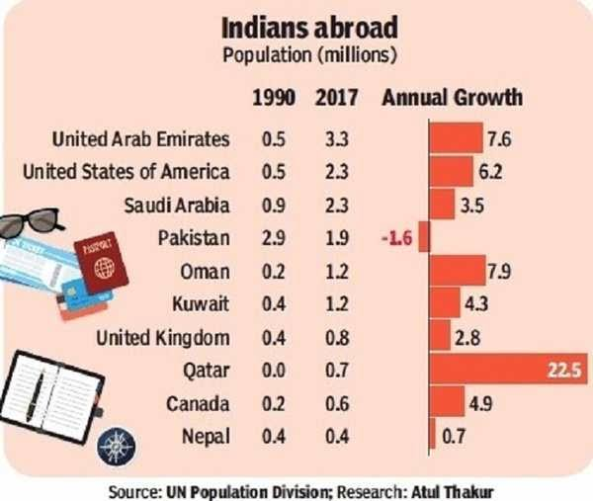
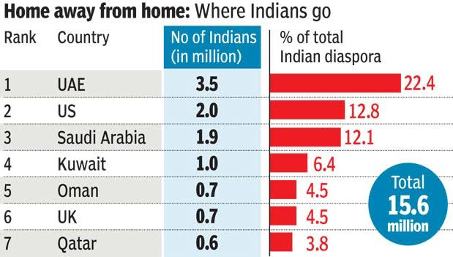
Indians abroad

Slide 7



Themes
It has its roots in the sense of loss and alienation, which emerged as a result of migration.
Generally, diasporic literature deals with alienation, displacement, existential rootlessness, nostalgia, quest of identity.
It also addresses issues related to amalgamation or disintegration of cultures.

Slide 8
Writers of Indian diaspora
Writers of diasporic Indian English literature include Amitav Ghosh, Salman Rushdie, Kamala Markandeya, Bharati Mukherjee, Chitra Banerjee Divakaruni, Anita Desai, Kiran Desai, Vikram Seth, Meena Alexander etc.

Slide 9
VS Naipaul
V. S. Naipaul is a diaspora writer who broadens the depth of diaspora by focusing on the painful problems of immigrants in his writing.
He occupies the unique place among the diaspora writers.
And he has given a creative direction to the diaspora writing.

Slide 10
House for Mr. Biswas
V. S. Naipaul is the most controversial novelist of our times.
The novel A House for Mr. Biswas (1961) is nothing but a struggling picture of East Indian people for getting a stable identity in West Indies.
The novel narrates the marginalized East Indian community in Trinidad.
The characters in the novel have to face many struggles to establish themselves with a place to live in an alien environment.
The house in this novel is a symbol not for homelessness but for freedom from slavery and injustice.
. The protagonist Mr. Mohun Biswas suffers a lot to find stability in his life.
The novel pictures about the pathetic condition of the immigrants who have nothing more expectation but a place to live in.

Slide 11

Conclusion
It aims to examine the displacement and the nostalgia for their homeland and alienation caused by displacement or dislocation as well as conflict between generations and cultural identity.
Diasporic writers tend to portray the cultural dilemmas, the generational differences, and transformation of their identities during displacement.

Slide 12
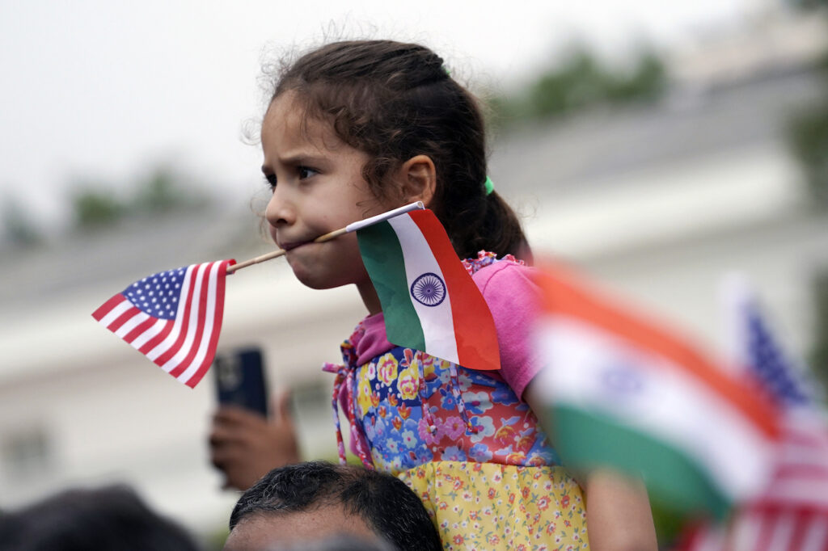
Thank you

