Slide 1
Theatre of Absurd
Phanindra Prasad
MA, B.ED, NE- SLET, UGC-NET
Address: Jengraimukh, Majuli. Assam- 785105
Email: phanindrap35@gmail.com
Phone: 8474018125

Slide 2
Origin
As a new form of drama, the Theater of the Absurd originated from France after The Second World War.
Its name was coined by Martin Esslin in his book The Theatre of the Absurd, which was published in 1960.
Playwrights of the Theater of the Absurd reveal the conditions of human beings’ existence in modern society.
This paper analyzes the artistic features and meaning of the Theater of the Absurd.

Slide 3
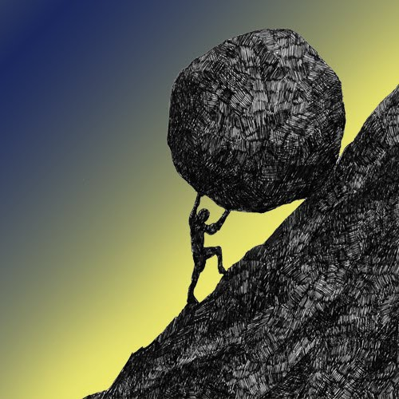
1. What is the Theatre of Absurd?

Slide 4
Albert Camus said, A man’s struggle to understand the World is very similar to the struggle of Sisyphus because Sisyphus’ existence only happen for the cause that he need to roll a heavy stone up a mountain only to watch it roll to the bottom, and then he has to roll it up to the mountain and it rolls back to the bottom.
Just like Sisyphus the life of human beings are also meaningless, they do monotonous work and keep doing it till they die. And alas no one gets affected by their death.
Theatre of Absurd takes the philosophy of Absurdity from Albert Camus’ Work “Myth of Sisyphus”

Slide 5
2. Who Coined?
The term theatre of Absurd was coined first by Martin Esslin in 1960
Used this term to describe a group of playwrights who were writing during 1950s and 1960s.

Slide 6
3. What are the Characteristics?
Theatre of Absurd is a form of drama that emphasizes the absurdity of human existence by employing:
Purposeless and confusing situations, and
Disjointed repetitious meaningless dialogue,
Plots that lack realistic or logical development.
Often start in an arbitrary point and end just as arbitrarily.

Slide 7
5.What Critics believed?
Critics believed that theatre of Absurd arose as a movement from the doubts and fears surrounding World War II and what many people saw as degeneration of Traditional, Moral and Political values.

Slide 8
6. Where it flourished?
The movement flourished in France, Germany, England and other European Countries.

Slide 9
7. Who were the Members?
The seven great members of the movement are:
1) Samuel Beckett- Waiting for Godot.
2) Harold Pinter – Homecoming
3) Jean Genet – Maids
4)Eugene Ionesco – Bald Suprano, The Chairs
5) Edward Albee – Zoo Story
6) Tom Stoppard – Rosencrantz and Guildenstern are Dead
7) Arthur Adamov- Ping Pong.

Slide 10
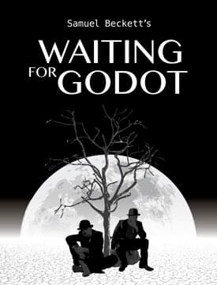
8. Example of the Absurd Play:
Waiting for Godot The Actions do not proceed logically, there is a contradiction and the end is not conclusive.
We don’t know what happened in the end. They kept on waiting for Godot and nothing happened,
The audience is unable to ever understand the characters, Whenever they are saying the dialogues we are unable to understand what they actually meant to say, the time or place of the play is not usually made clear.

Slide 11
9. What is the Purpose of Absurd Theatre?
The Theatre of the Absurd attacks the comfortable certainties of religious or political orthodoxy.
It aims to shock its audience out of complacency, to bring it face to face with the harsh facts of the human situation as these writers see it.

Slide 12
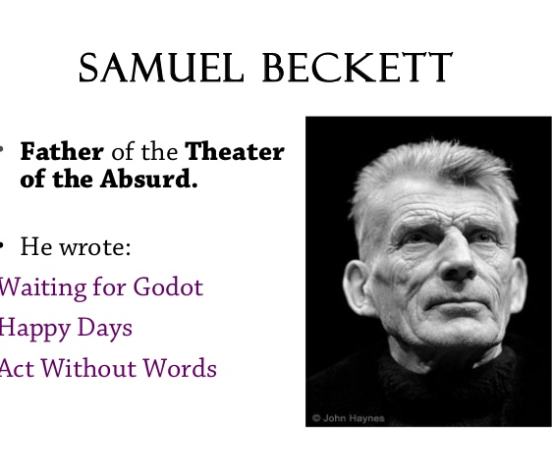

Slide 13
Waiting for Godot: Its Absurd Characteristics
Austere Stage Setting
Tramps as protagonists
Static Nature of the Play
Lack of Coherent story, plot

Slide 14
The End
This movement ended when Beckett died in 1989.

Slide 15
Thank you
Phanindra Prasad
Jengraimukh, Majuli. Assam- 785105

